Slide 1
Gene Set Analysis
HUGEN 2073
Jon Chernus

Slide 2
What can you do with a list of genes?
We can do “variant → gene” inference at each locus, using
LD/position
Known trait associations
eQTLS (in a later lecture)
Etc.
Put all the loci together → a list of genes

Slide 3
How can you interpret a list of genes?
Suppose your study (e.g., GWAS) yielded a list of dozens (or more) genes
Why not just publish a list of genes and stop there?
Are all those genes necessarily relevant?
What scientific/statistical question(s) can you ask about the list?

Slide 4
Gene set analysis
“Are certain categories of genes over-represented in my results, compared to what would be expected by chance?”
Originally used for differential expression studies
Includes or can be sometimes synonymous with
“enrichment analysis”
“over-representation analysis”
Etc.
Some considerations
What is the null hypothesis of a given method?
Some methods can include effect sizes and directions (instead of gene names)

Slide 5
Over-representation/enrichment
When asking what categories of genes are over-represented among a prioritized list of genes, what kinds of categories exist?
What kinds of categories might you be interested in? (Discuss)

Slide 6
Over-representation
Example: a GWAS of telomere length https://www.medrxiv.org/content/10.1101/2021.03.23.21253516v1
Key components of telomere regulatory complexes found within genome-wide significant loci.
Proteins depicted in green are found within GWAS loci, those not found within GWAS loci are depicted in blue.
We find the majority of components of core telomere binding complexes alongside many proteins involved in the formation and activity of telomerase. Note that not all components of the RNA exosome are shown.

Slide 7
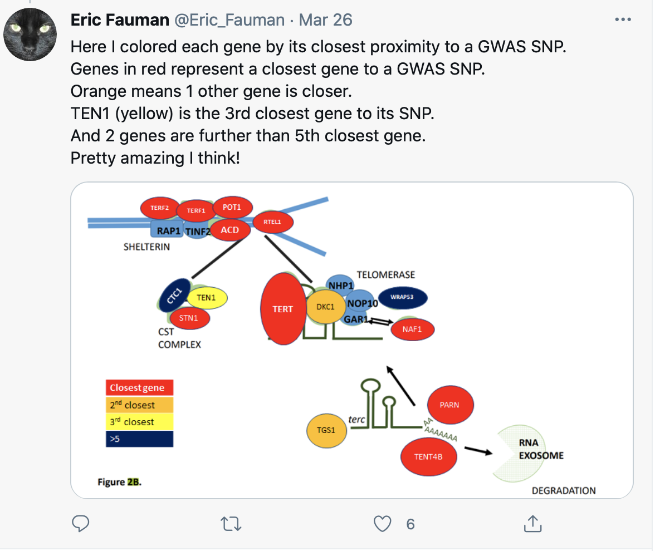
Over-representation
It looks like “telomerase-maintenance” genes are probably over-represented in these GWAS results.
(In a GWAS of telomere length, this is not surprising.)
But how to quantify the over-representation?

Slide 8
Some examples of gene sets/databases/tools
Gene Ontologies (GO) (http://geneontology.org)
PANTHER (http://www.pantherdb.org)
KEGG (https://www.genome.jp/kegg/)
IPA (https://digitalinsights.qiagen.com/products-overview/discovery-insights-portfolio/analysis-and-visualization/qiagen-ipa/; not free)
Pathway Commons (https://www.pathwaycommons.org)
Reactome (https://reactome.org)
GREAT (http://great.stanford.edu/public/html/)
GSEA (https://www.gsea-msigdb.org/gsea/index.jsp)
DAVID (https://david.ncifcrf.gov)
MAGMA (https://ctg.cncr.nl/software/magma)
FUMA (GENE2FUNC function; MAGMA) (https://fuma.ctglab.nl)
Enrichr (https://maayanlab.cloud/Enrichr/)
STRING

Slide 9
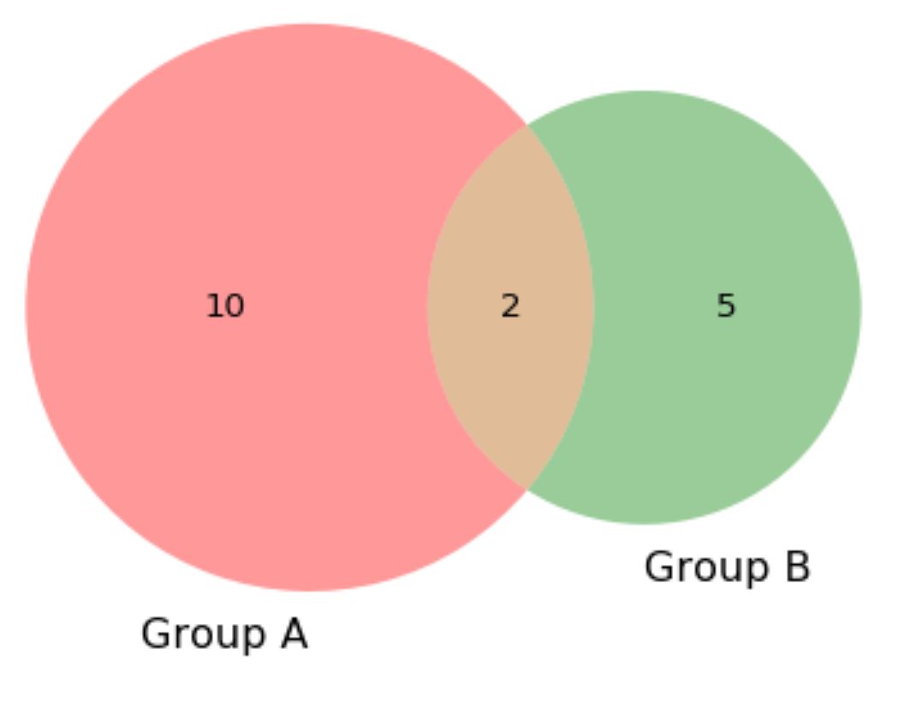
The simplest over-representation test
Venn diagram to show enrichment
Rest of the genome
Overlap
Your list
Reference gene set

Slide 10



Hypergeometric test (Fisher’s exact test)
What’s the probability of an overlap at least this big?
You picked n=7 GWAS genes out of the genome (N≈20,000)
The gene set had K=10 genes, overlapping k=2 of your genes
Number of ways to pick b balls from an urn with a total balls:
How many ways could you pick 7 genes out of the genome?
How many ways could you get an overlap of exactly 2?
So P[overlap exactly k=2] = 🫠 / 😱
Rest of the genome
_{a}$Cb=\left({a \atop b}\right)= \frac{a!}{\left(a−b\right)!(b!)}$
= size of gene set = 12
Overlap
= overlap of your genes with gene set = 2
_{N}$Cn=\left({20000 \atop 7}\right)= \frac{20000!}{\left(20000−7\right)!(7!)}$ = 🫠
= total number of genes “out there” = 20
Your list
= genes from your analysis = 7
Reference gene set
_{K}$Ck∗\text{N}\text{-}\text{K}C\text{n}\text{-}\text{k}=\left({10 \atop 2}\right)∗\left({20,000−10 \atop 5}\right)= \frac{10!}{\left(10−2\right)!\left(2!\right)} ∗\frac{(20,000−10)!}{\left((20,000−10)−5\right)!(5!)}$ = 😱
Finally, $Phypergeometric=$ P[see overlap at least this big)] = $\sum_{i=k}^{min(K,n)}{P(overlap exactly i)}$
Notes:
Experiment
Draw n observations without replacement from a total population of size N
S out of N are “successes”
What’s the probability of drawing exactly s of the S “successes” in your sample of size n?
Or, what’s the probability of exactly this much overlap between your sample and the “success” set, S $⊆$ N?
To estimate significance of the overlap, we need to know the size of the “universe”/population (N)!

Slide 11
Gene Ontologies
http://geneontology.org
Gene ontology (GO) is a formalized system for categorizing/annotating genes according to their biological functions.
This makes it easier to systematically compare gene sets and also can help keep track of similar genes across different organisms.
Every gene has assigned three “aspects”
Molecular function
Cellular component
Biological process

Slide 12
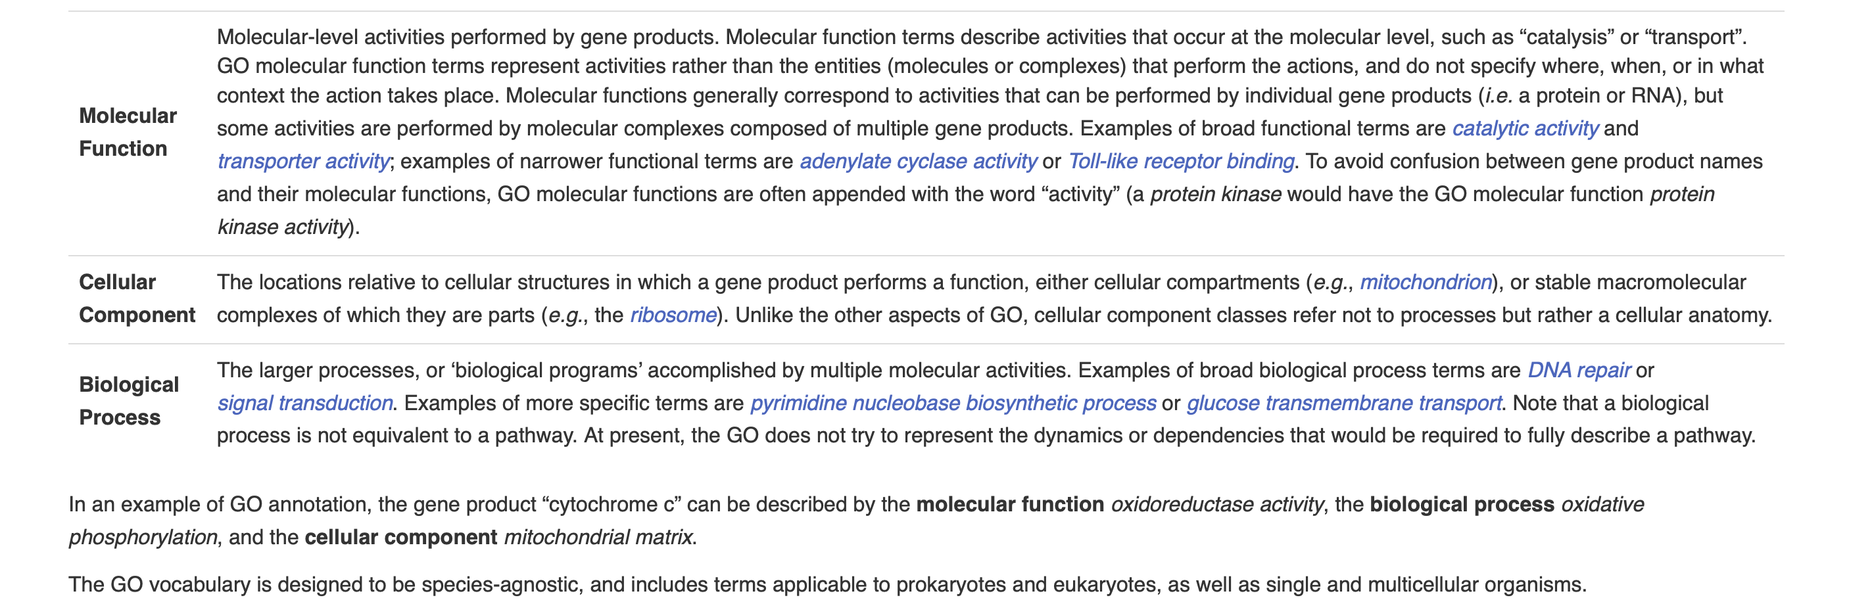
Gene Ontologies - aspects

Slide 13
Gene Ontologies – GO terms
Each possible aspect is arranged in a hierarchy or “tree” ranging from the most general to the most specific.
If a gene belong to a specific class, it also belongs to call of the “parent” classes in the hierarchy containing that class.
The entire system of classes can be described with a formalized logical vocabulary.

Slide 14
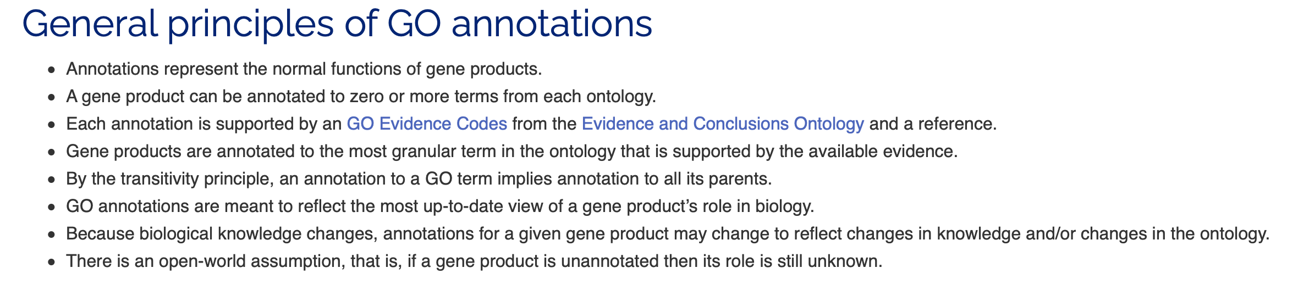
Gene Ontologies – GO terms

Slide 15
Gene Ontologies – GO terms
The possible values for a given aspect are called GO terms or classes and have unique identifiers and descriptions:

Slide 16
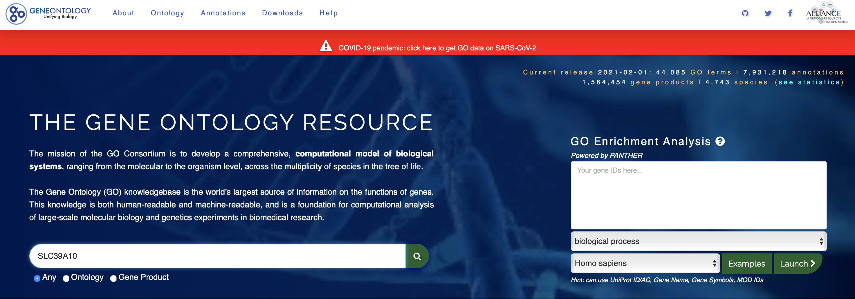
Gene Ontologies
Searching a gene

Slide 17
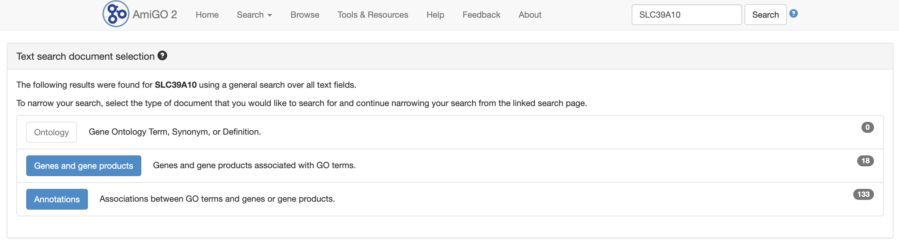
Gene Ontologies
Search results. Let’s click on “genes and gene products.”

Slide 18
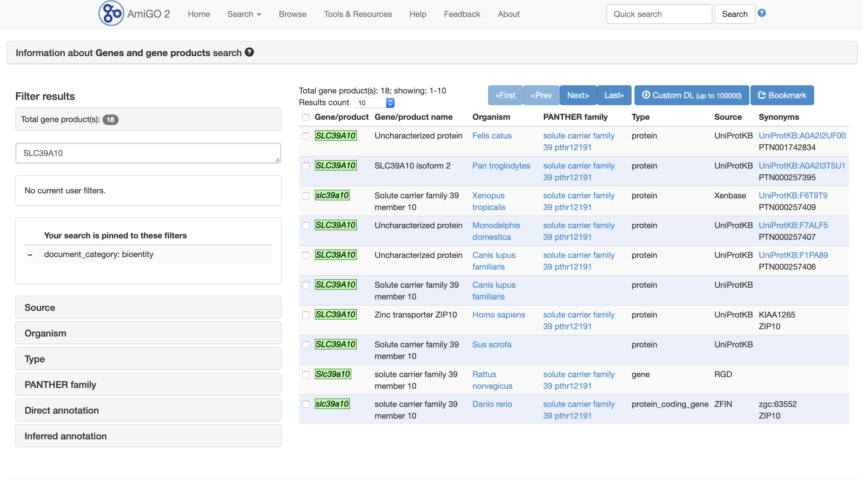
Gene Ontologies
Let’s select Homo sapiens.

Slide 19
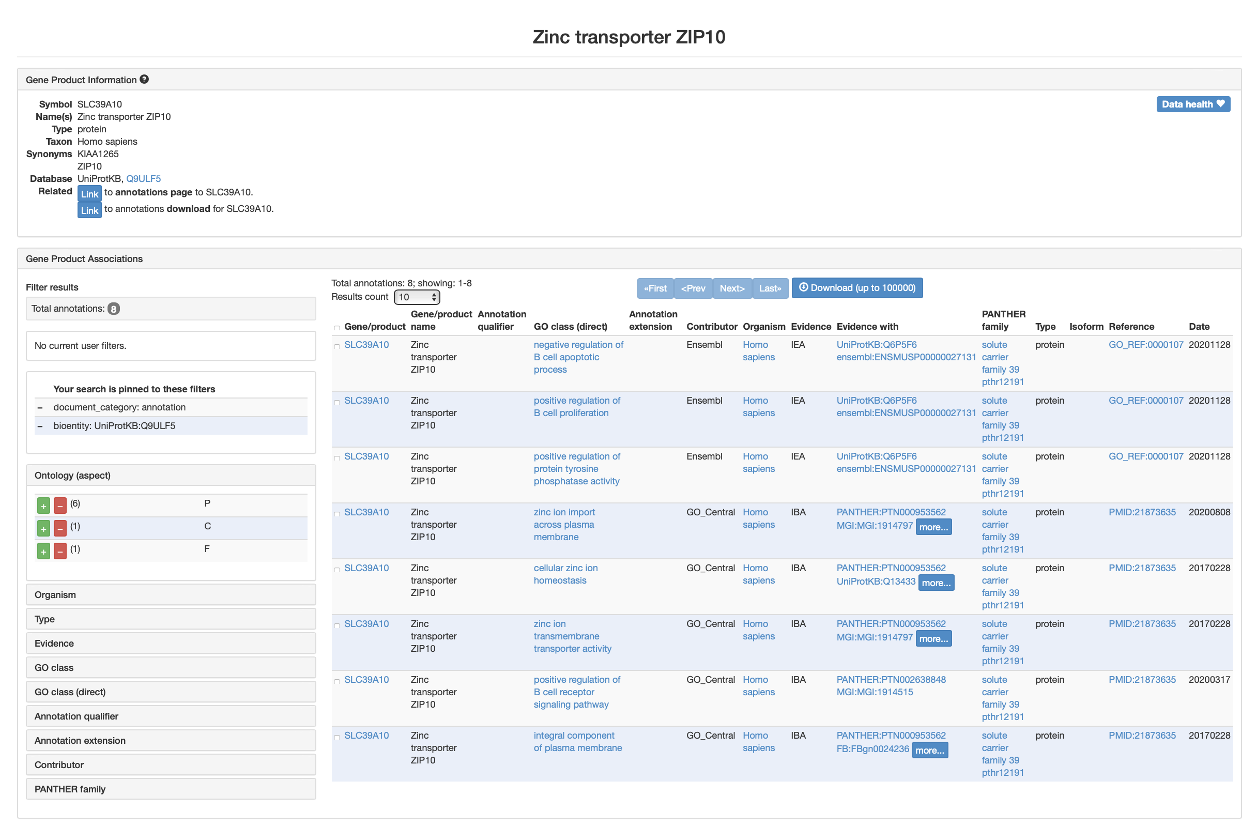
Gene Ontologies
Results for SLC39A10

Slide 20
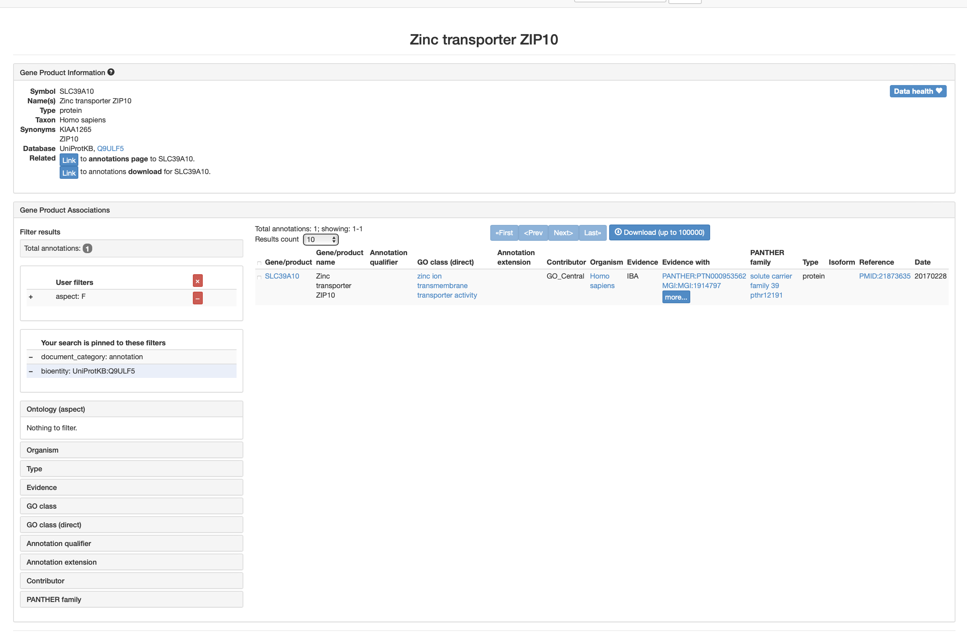
Gene Ontologies
Results for SLC39A10. Filter to show only aspect F (function)

Slide 21
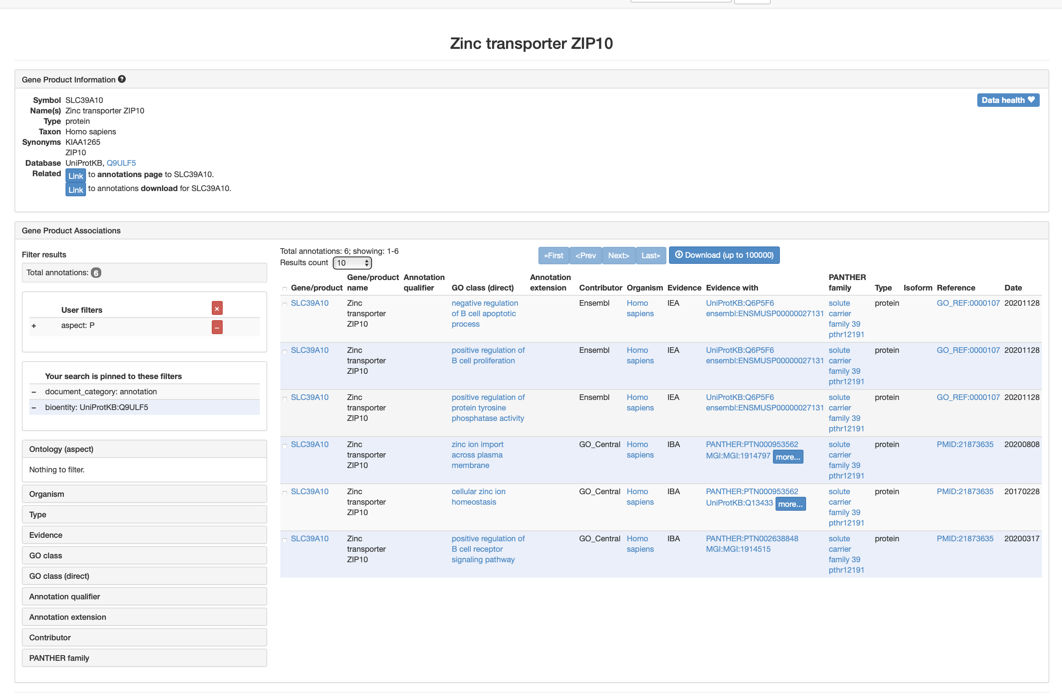
Gene Ontologies
Results for SLC39A10. Filter to show only aspect P (process)

Slide 22
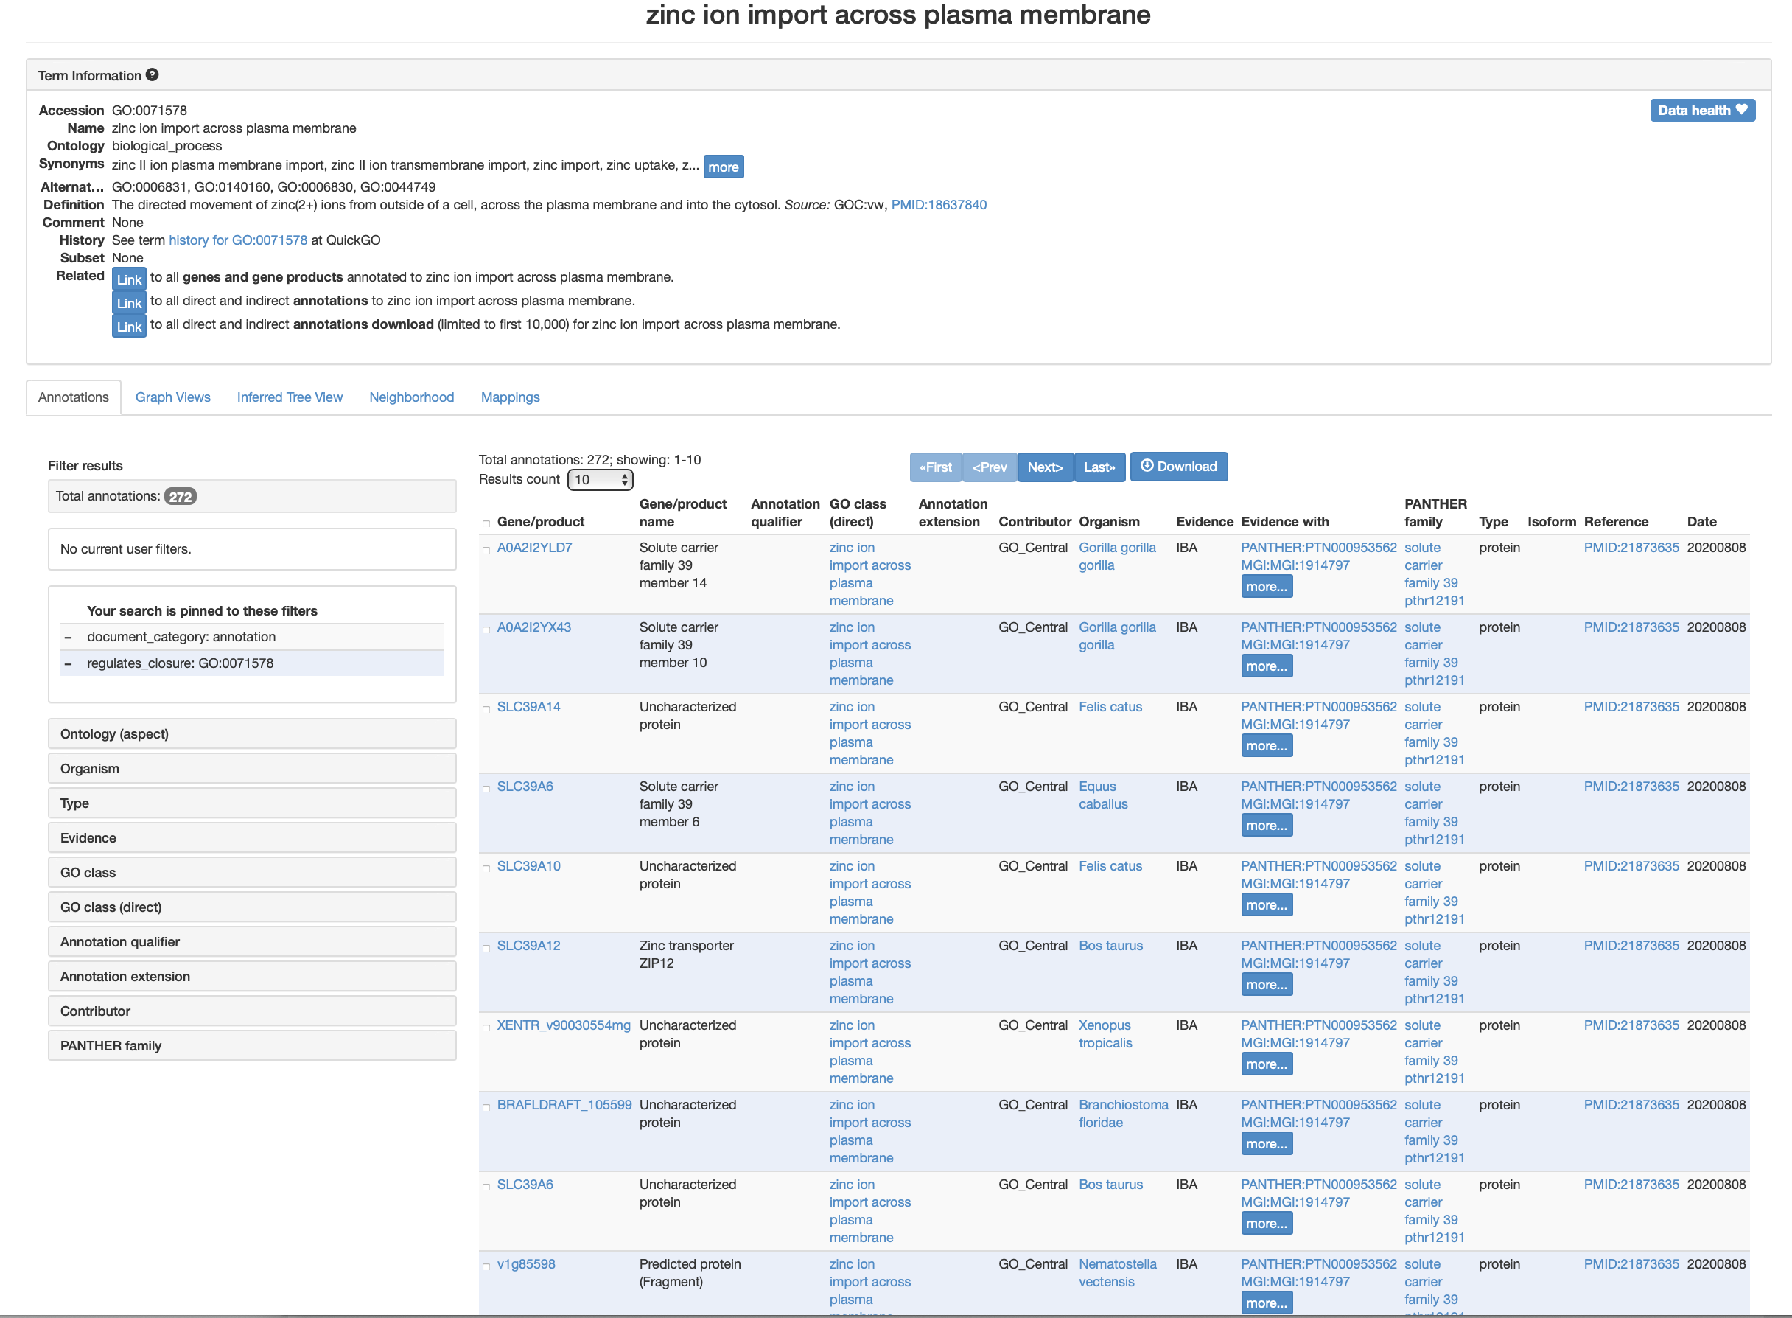
Gene Ontologies
Result of clicking on one of the GO terms: “zinc ion import across plasma membrane.”

Slide 23
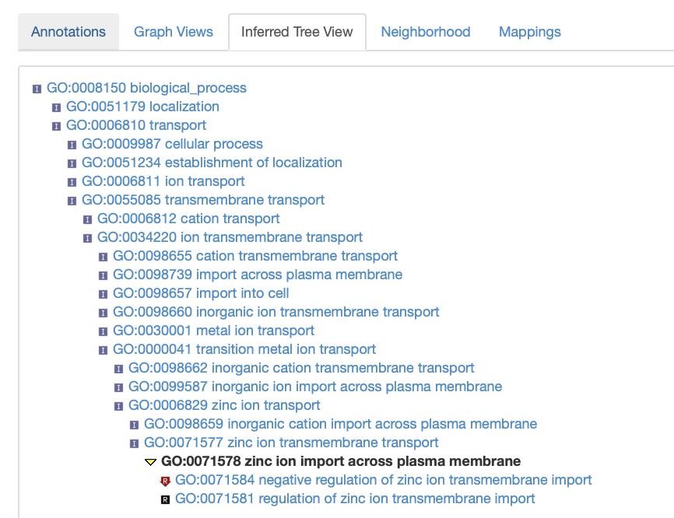
Gene Ontologies
Result of clicking on “Inferred Tree View”

Slide 24
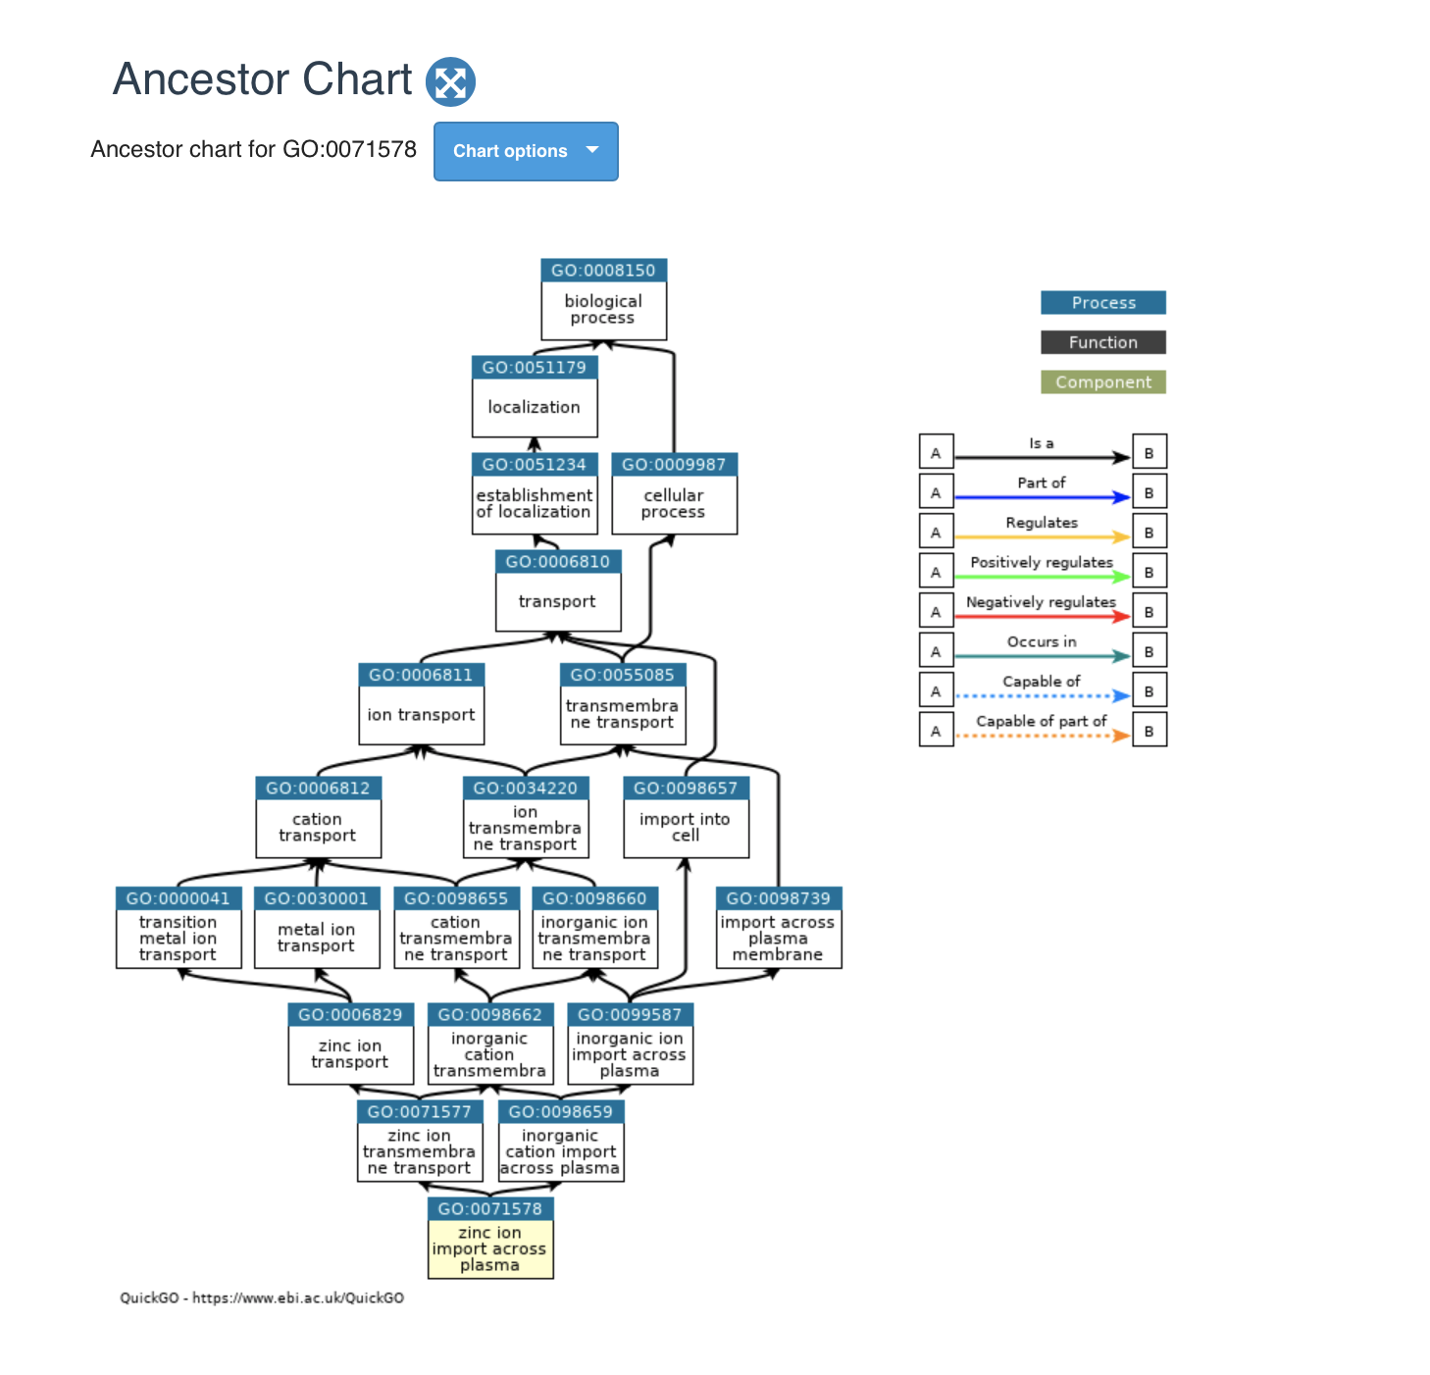
Gene Ontologies
An option from “Graph Views”

Slide 25
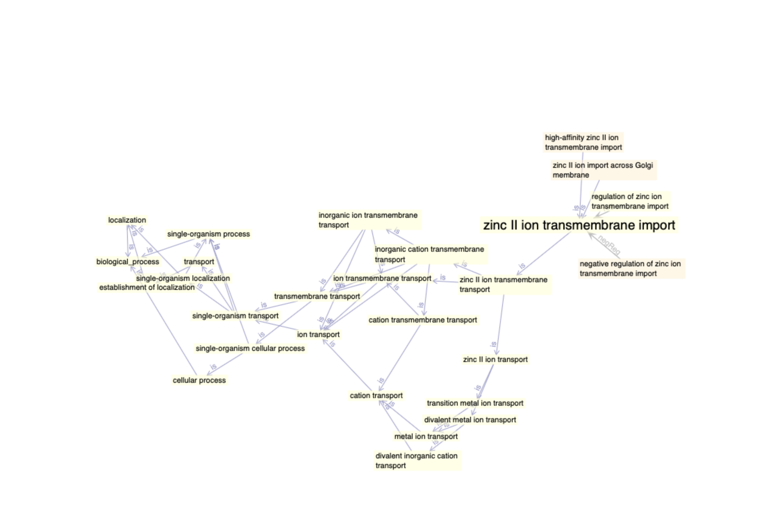
Gene Ontologies
Another option from “Graph Views”

Slide 26
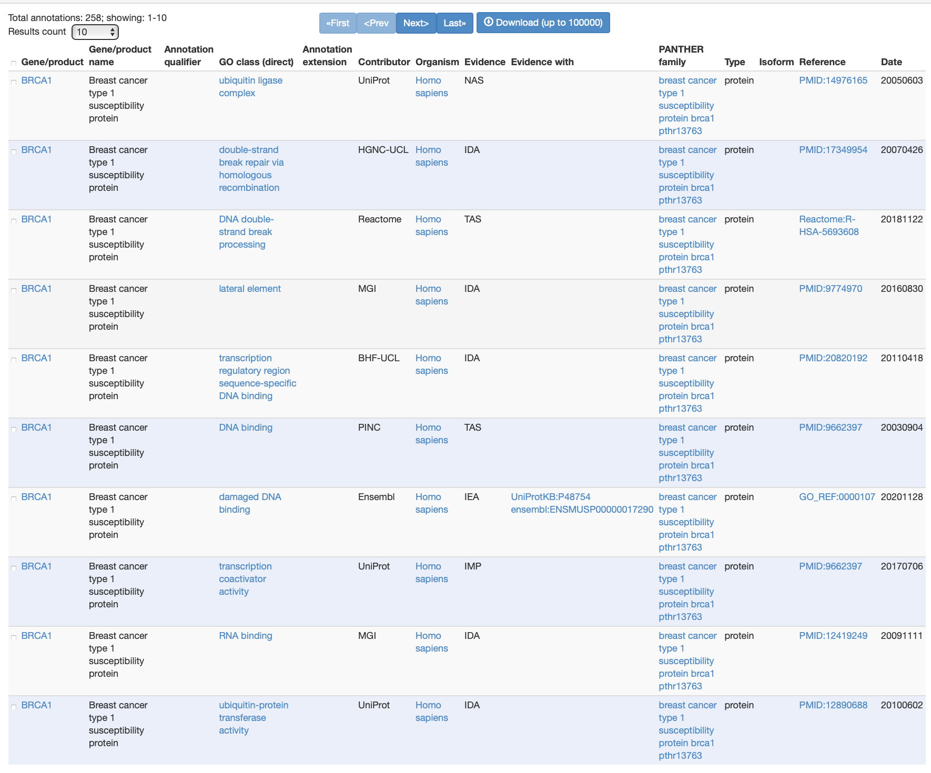
Gene Ontologies – sources and evidence

Slide 27
Experimental Evidence evidence codes: Inferred from Experiment (EXP) Inferred from Direct Assay (IDA) Inferred from Physical Interaction (IPI) Inferred from Mutant Phenotype (IMP) Inferred from Genetic Interaction (IGI) Inferred from Expression Pattern (IEP)
Notes:
This text slide was borrowed from Frank Fan’s presentation.

Slide 28
Computational Analysis evidence codes: Inferred from Sequence or structural Similarity (ISS) Inferred from Sequence Orthology (ISO) Inferred from Sequence Alignment (ISA) Inferred from Sequence Model (ISM) Inferred from Genomic Context (IGC) Inferred from Biological aspect of Ancestor (IBA) Inferred from Biological aspect of Descendant (IBD) Inferred from Key Residues (IKR) Inferred from Rapid Divergence (IRD) Inferred from Reviewed Computational Analysis (RCA)
Notes:
This text slide was borrowed from Frank Fan’s presentation.

Slide 29
Author Statement evidence codes: Traceable Author Statement (TAS) Non-traceable Author Statement (NAS) Curatorial Statement codes: Inferred by Curator (IC) No biological Data available (ND) evidence code Automatically-Assigned evidence code: Inferred from Electronic Annotation (IEA)
Notes:
This text slide was borrowed from Frank Fan’s presentation.

Slide 30
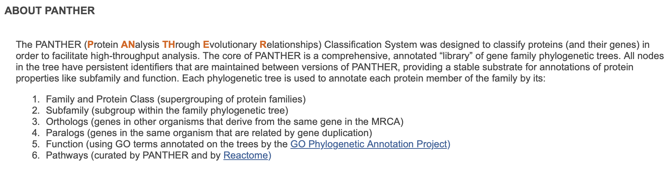
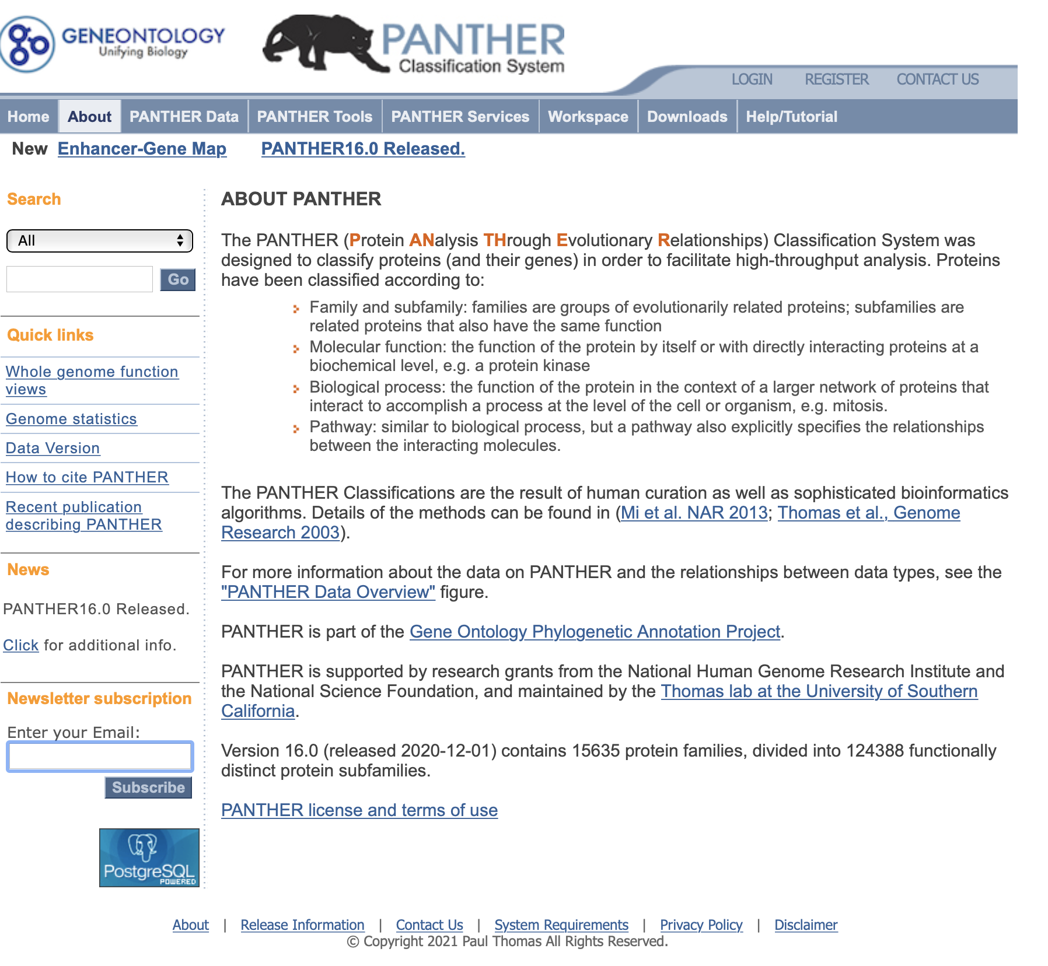
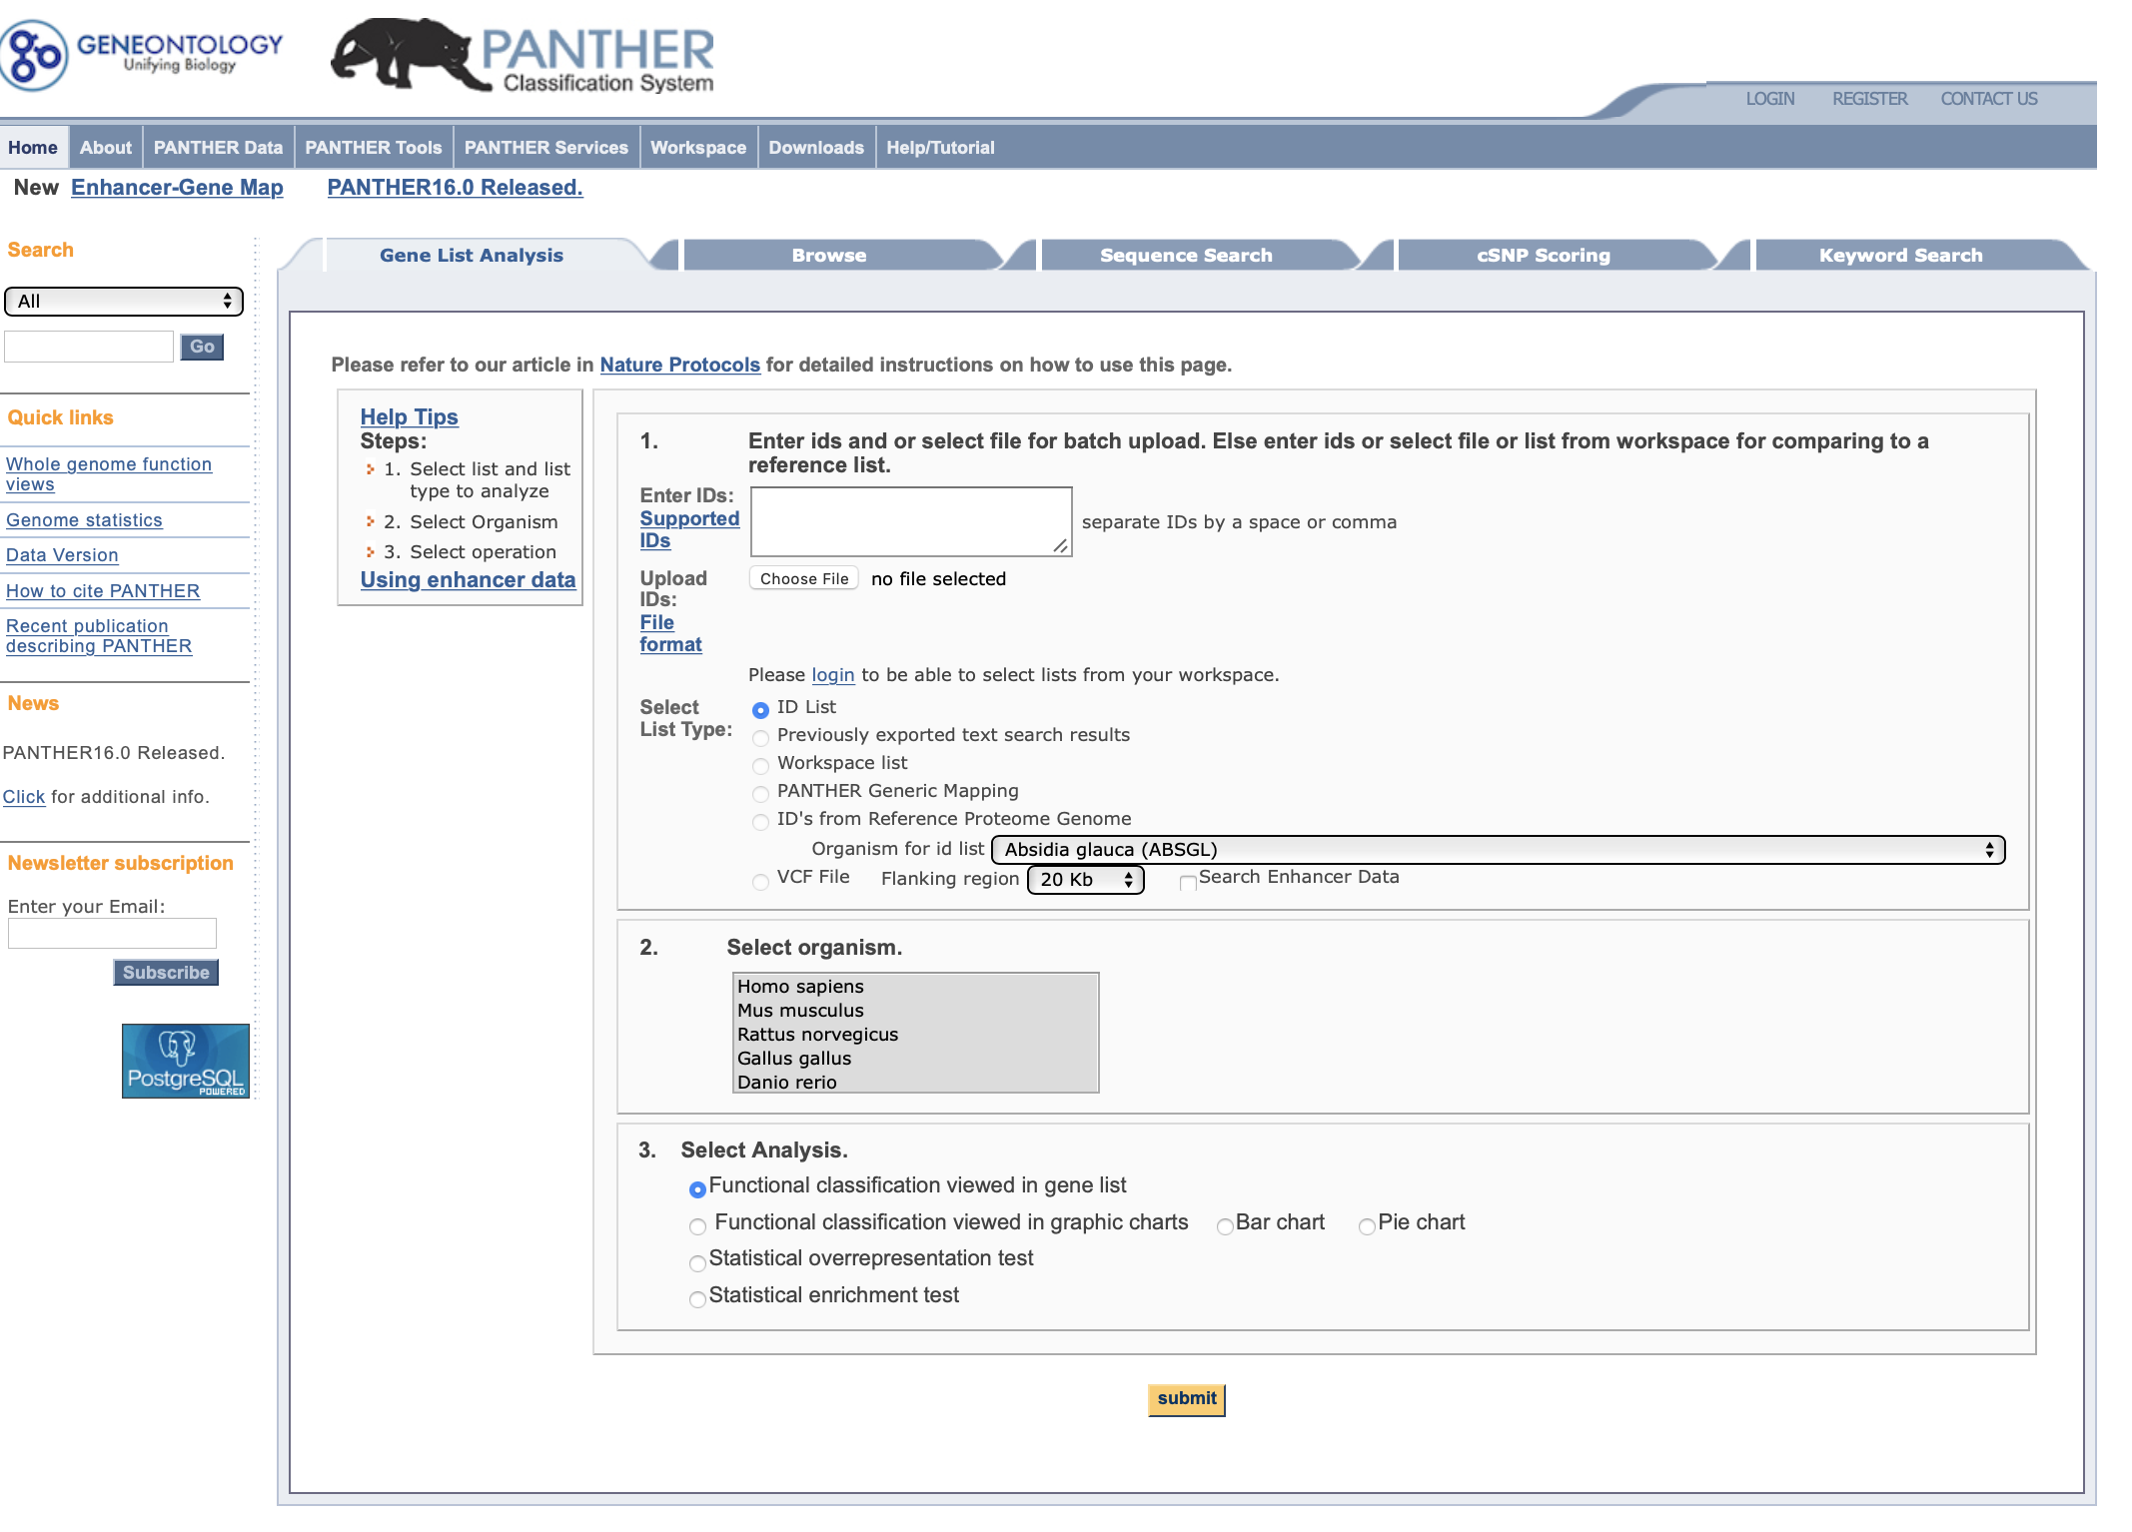
PANTHER
http://pantherdb.org

Slide 31
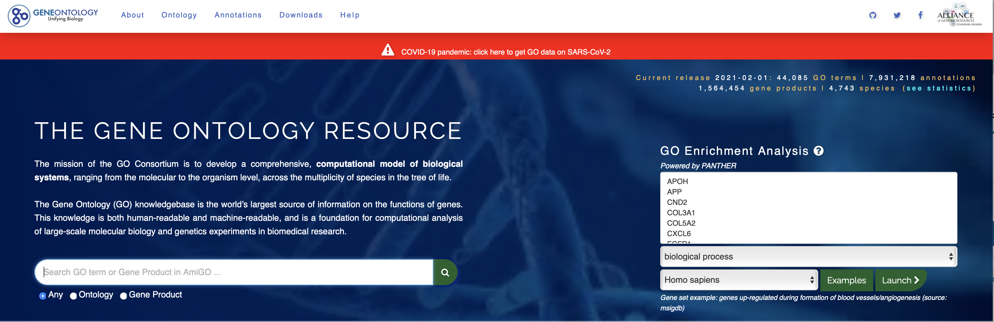
GO enrichment analysis (PANTHER)
Enter a list of genes and click Launch >

Slide 32
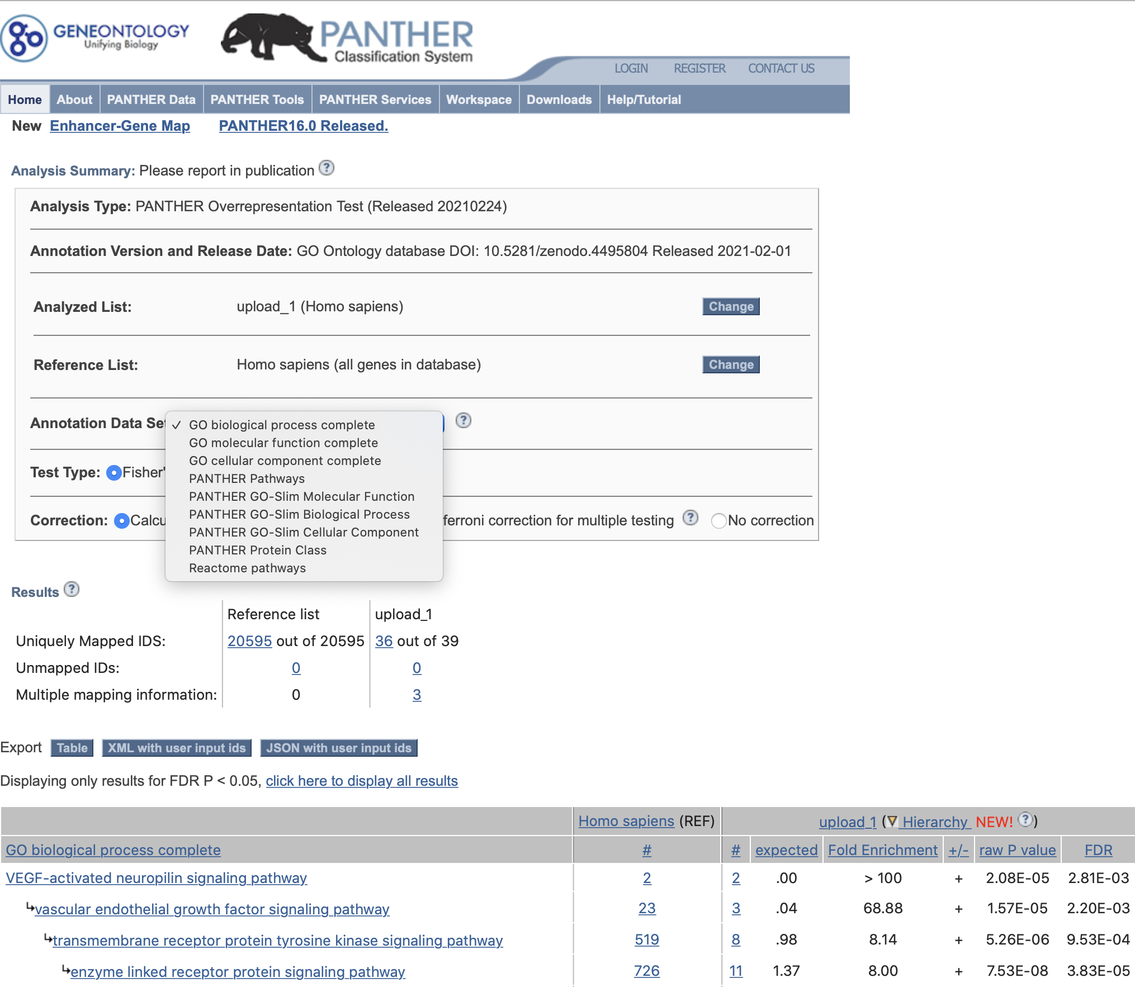
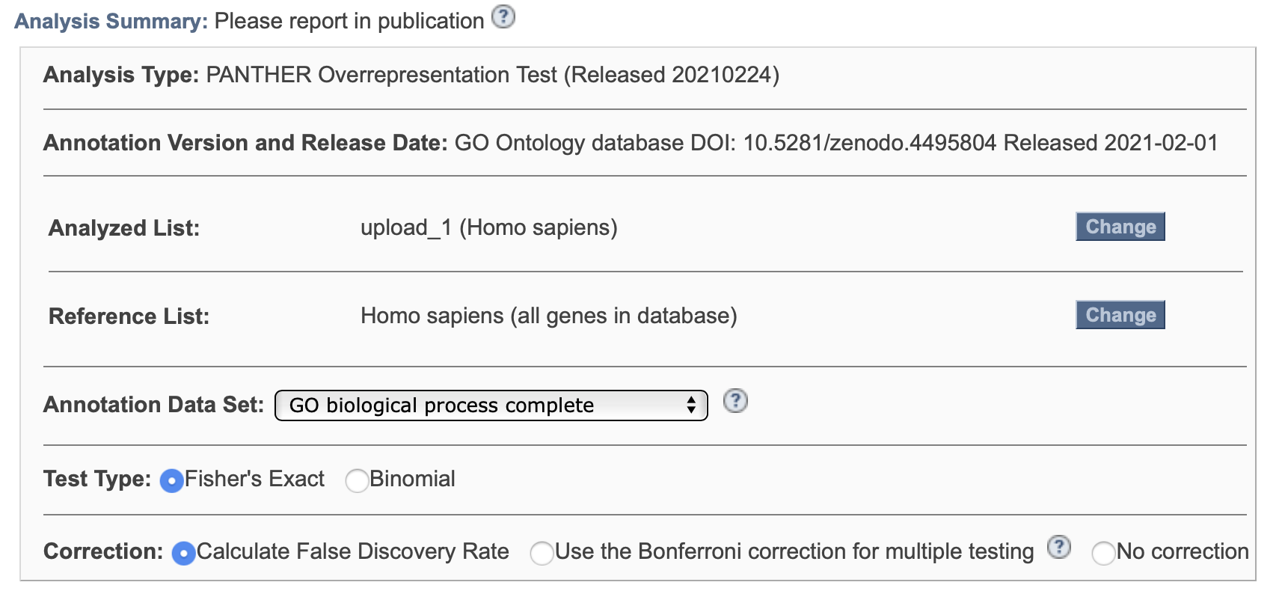
GO enrichment analysis (PANTHER)
PANTHER results page. Notice you can select different gene sets/ontology sets and different statistical options.

Slide 33
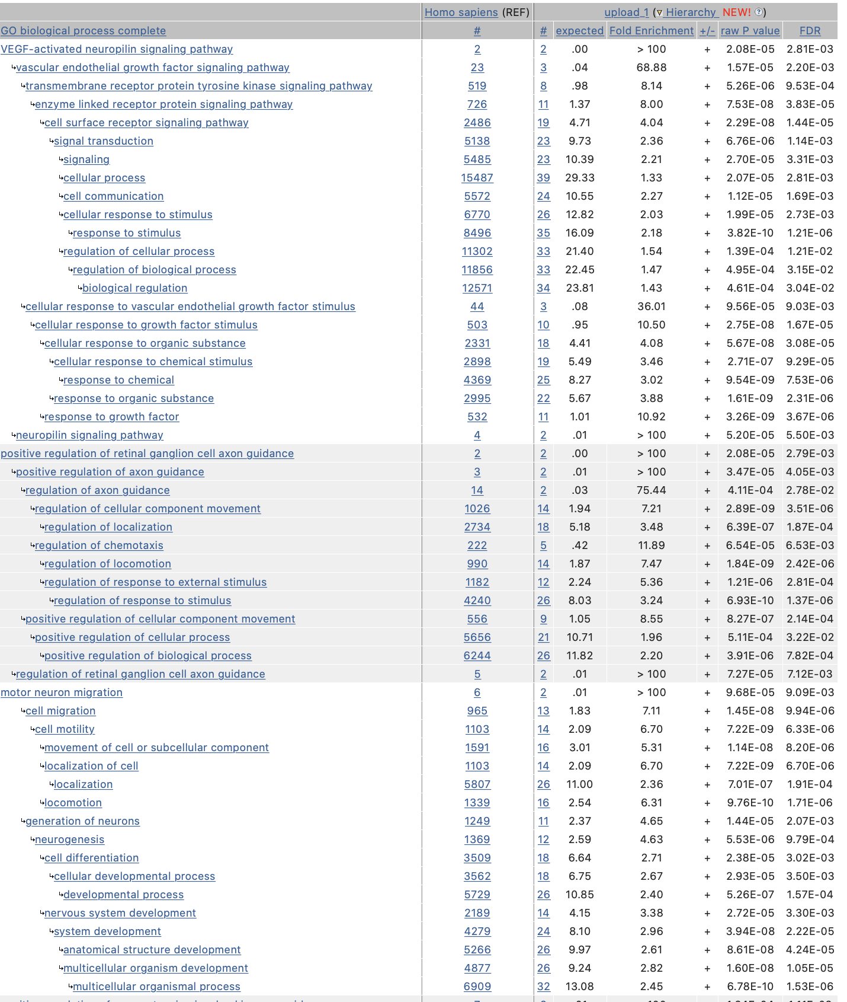
GO enrichment analysis (PANTHER)
Number of genes in your gene set mapping to a given annotation (vs expected)
# /( expected #)
PANTHER results
Total number of human genes mapping to a given annotation
Enriched vs. depleted
P-value and false discovery rate
Test each annotation for enrichment
Grouped by narrowest annotation category
Sorted within group from most specific to most general

Slide 34
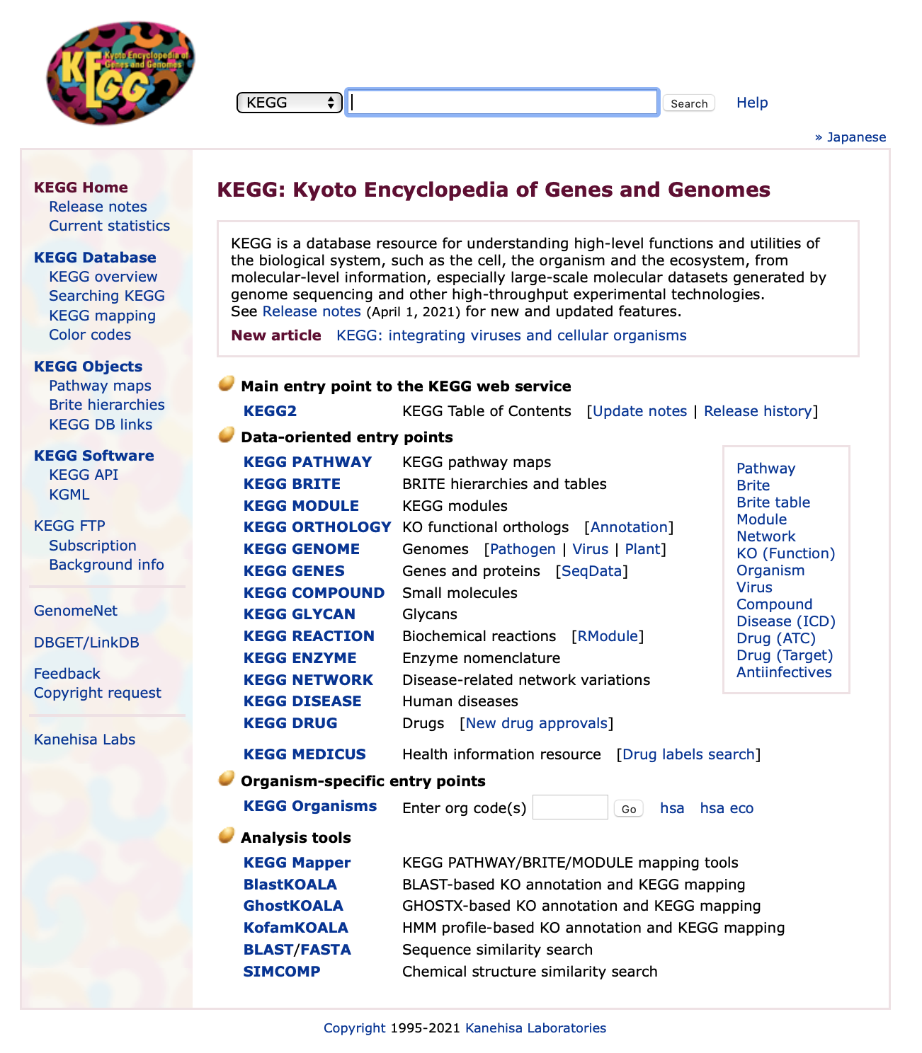
KEGG
https://www.genome.jp/kegg/
KEGG is a set of related databases.
KEGG PATHWAY is the most important part for our purposes.

Slide 35
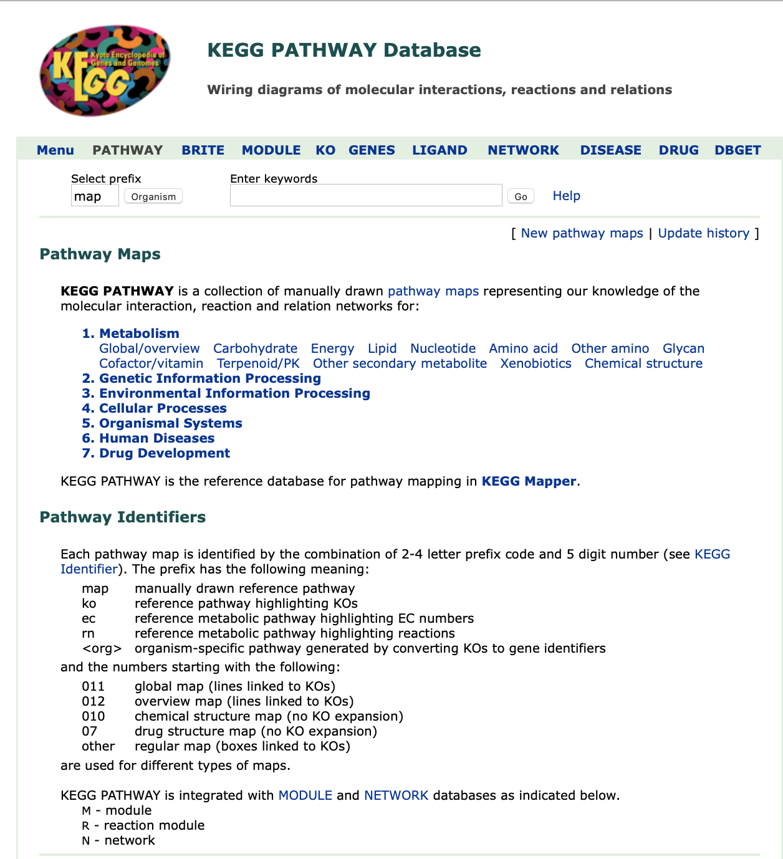
KEGG PATHWAY
A collection of manually drawn pathway maps.
Pathways fall into 7 categories.

Slide 36
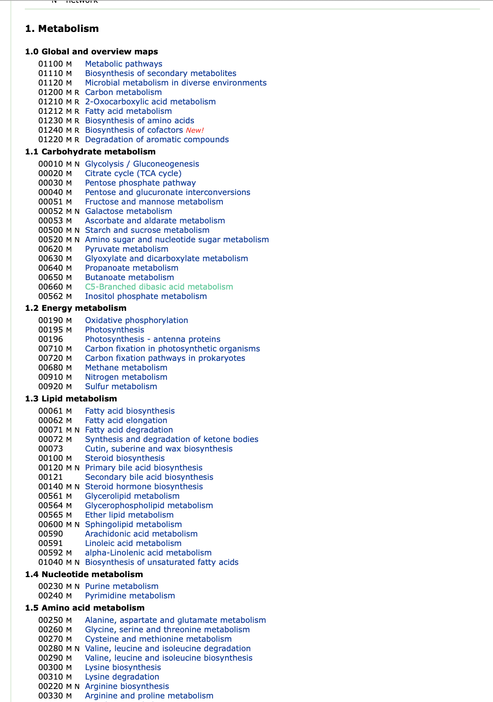
KEGG PATHWAY
A few of the KEGG pathways.
Let’s select “Metabolic pathways” (the entire category).

Slide 37
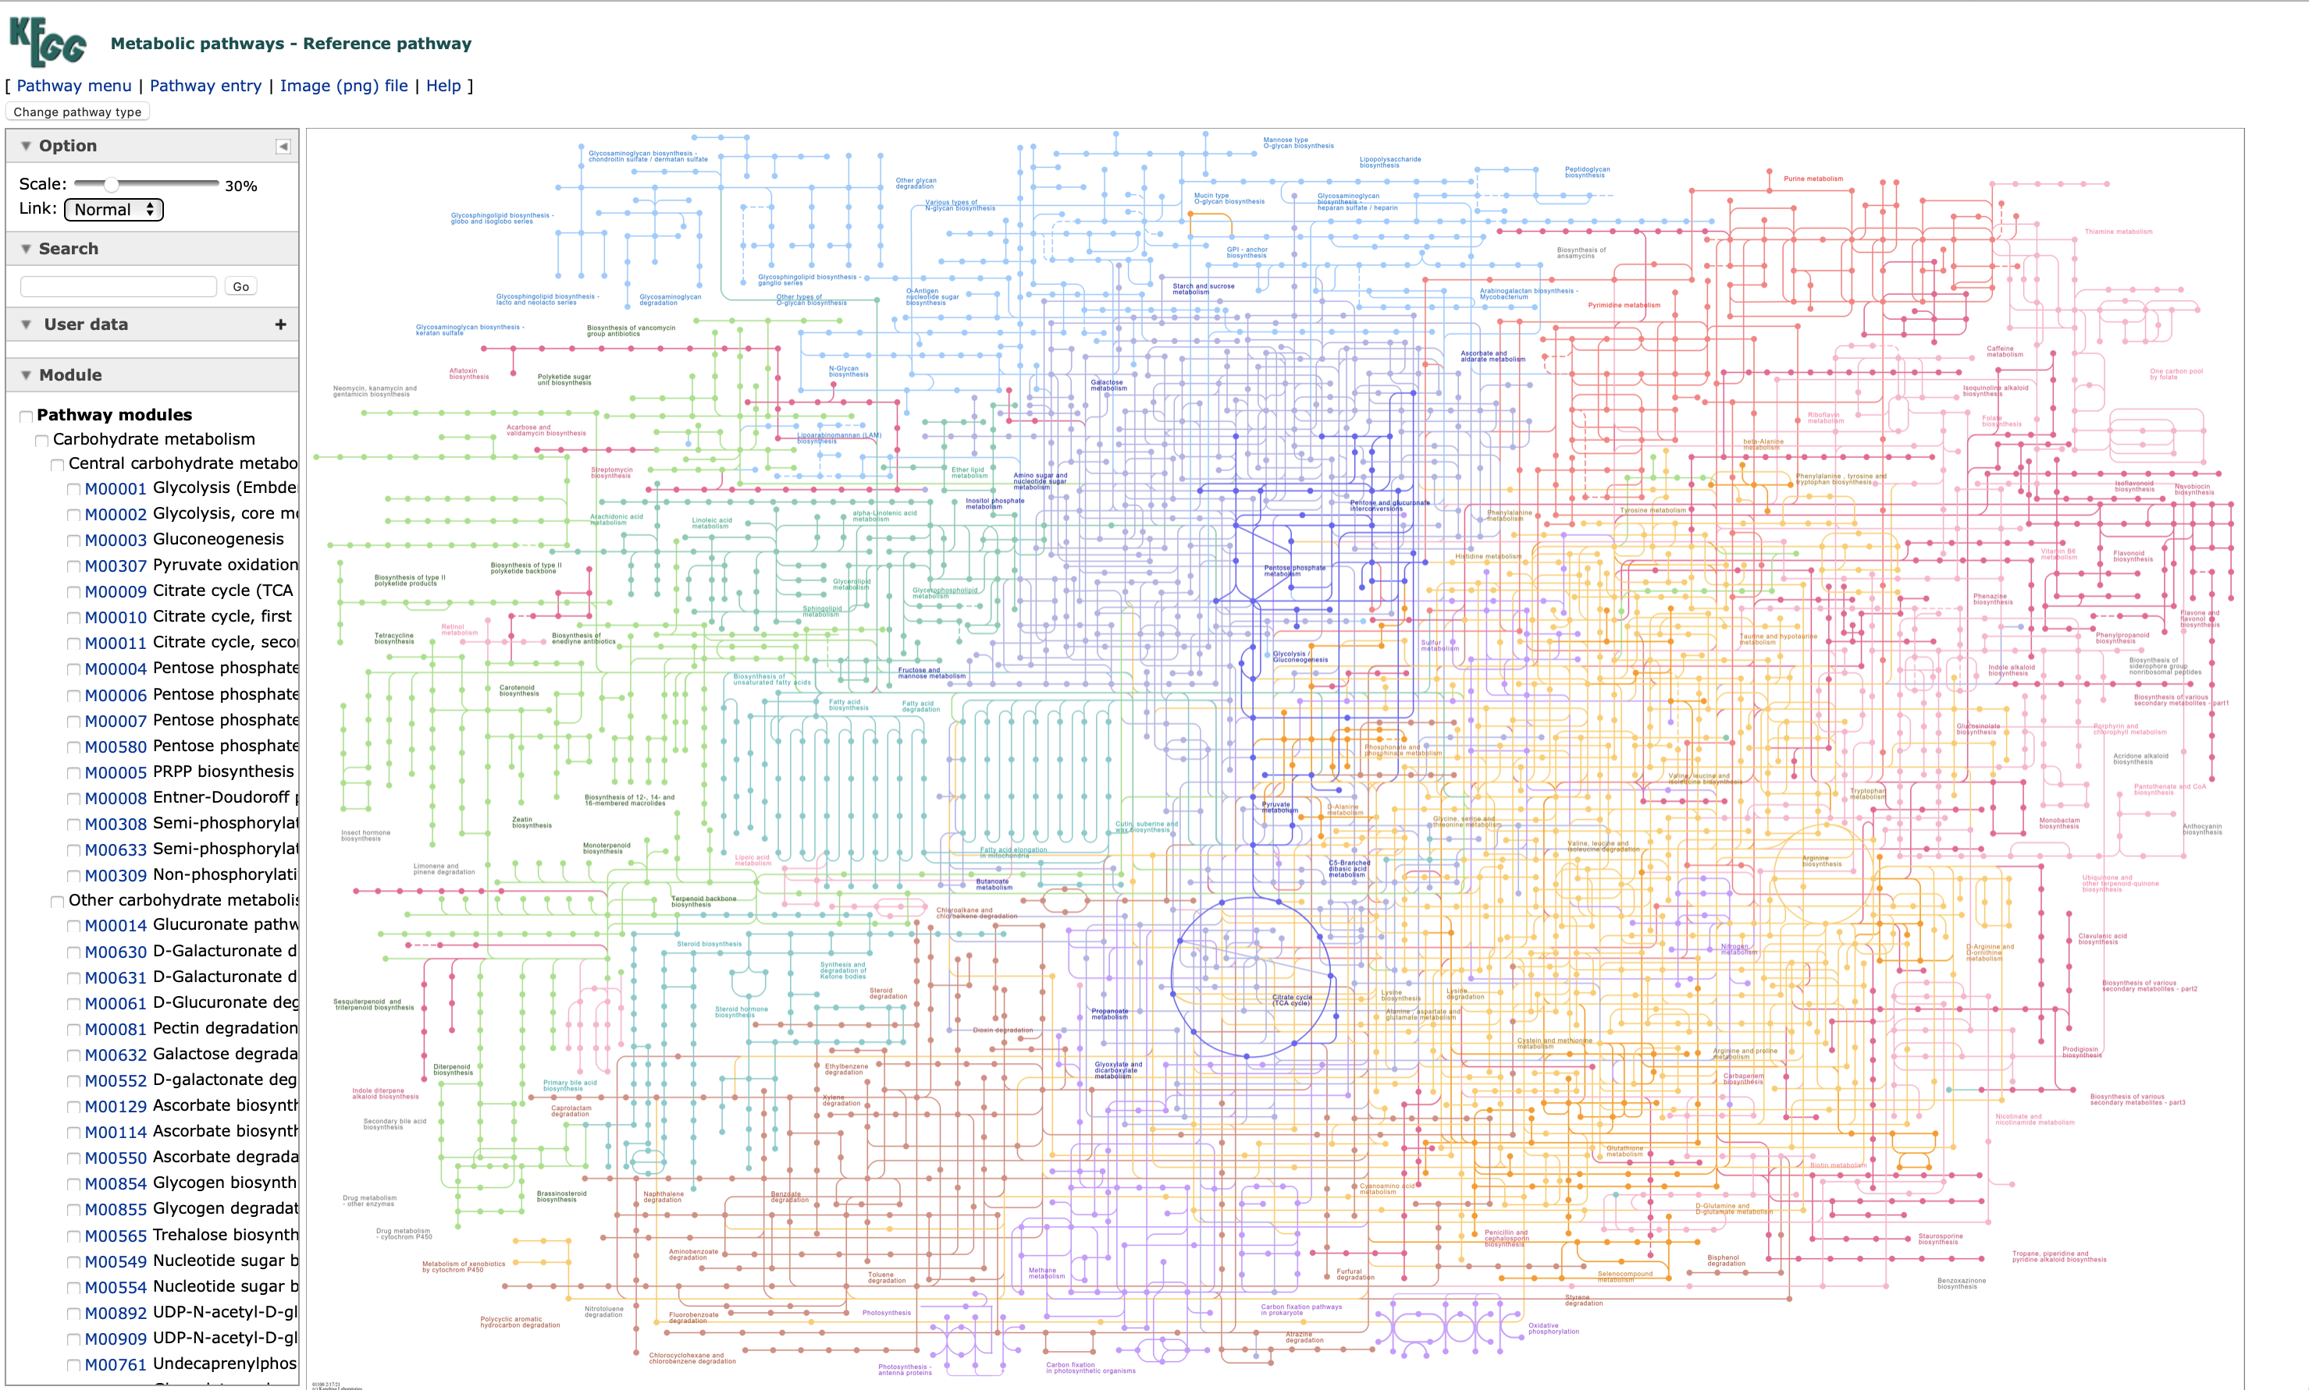

Slide 38
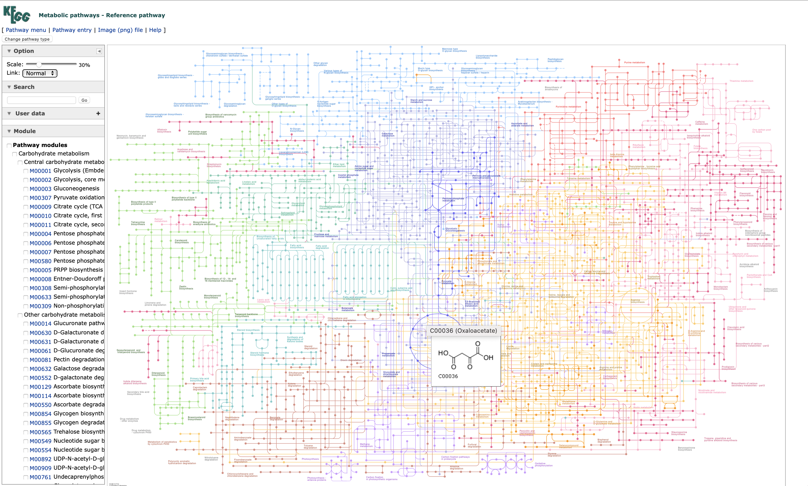

Slide 39
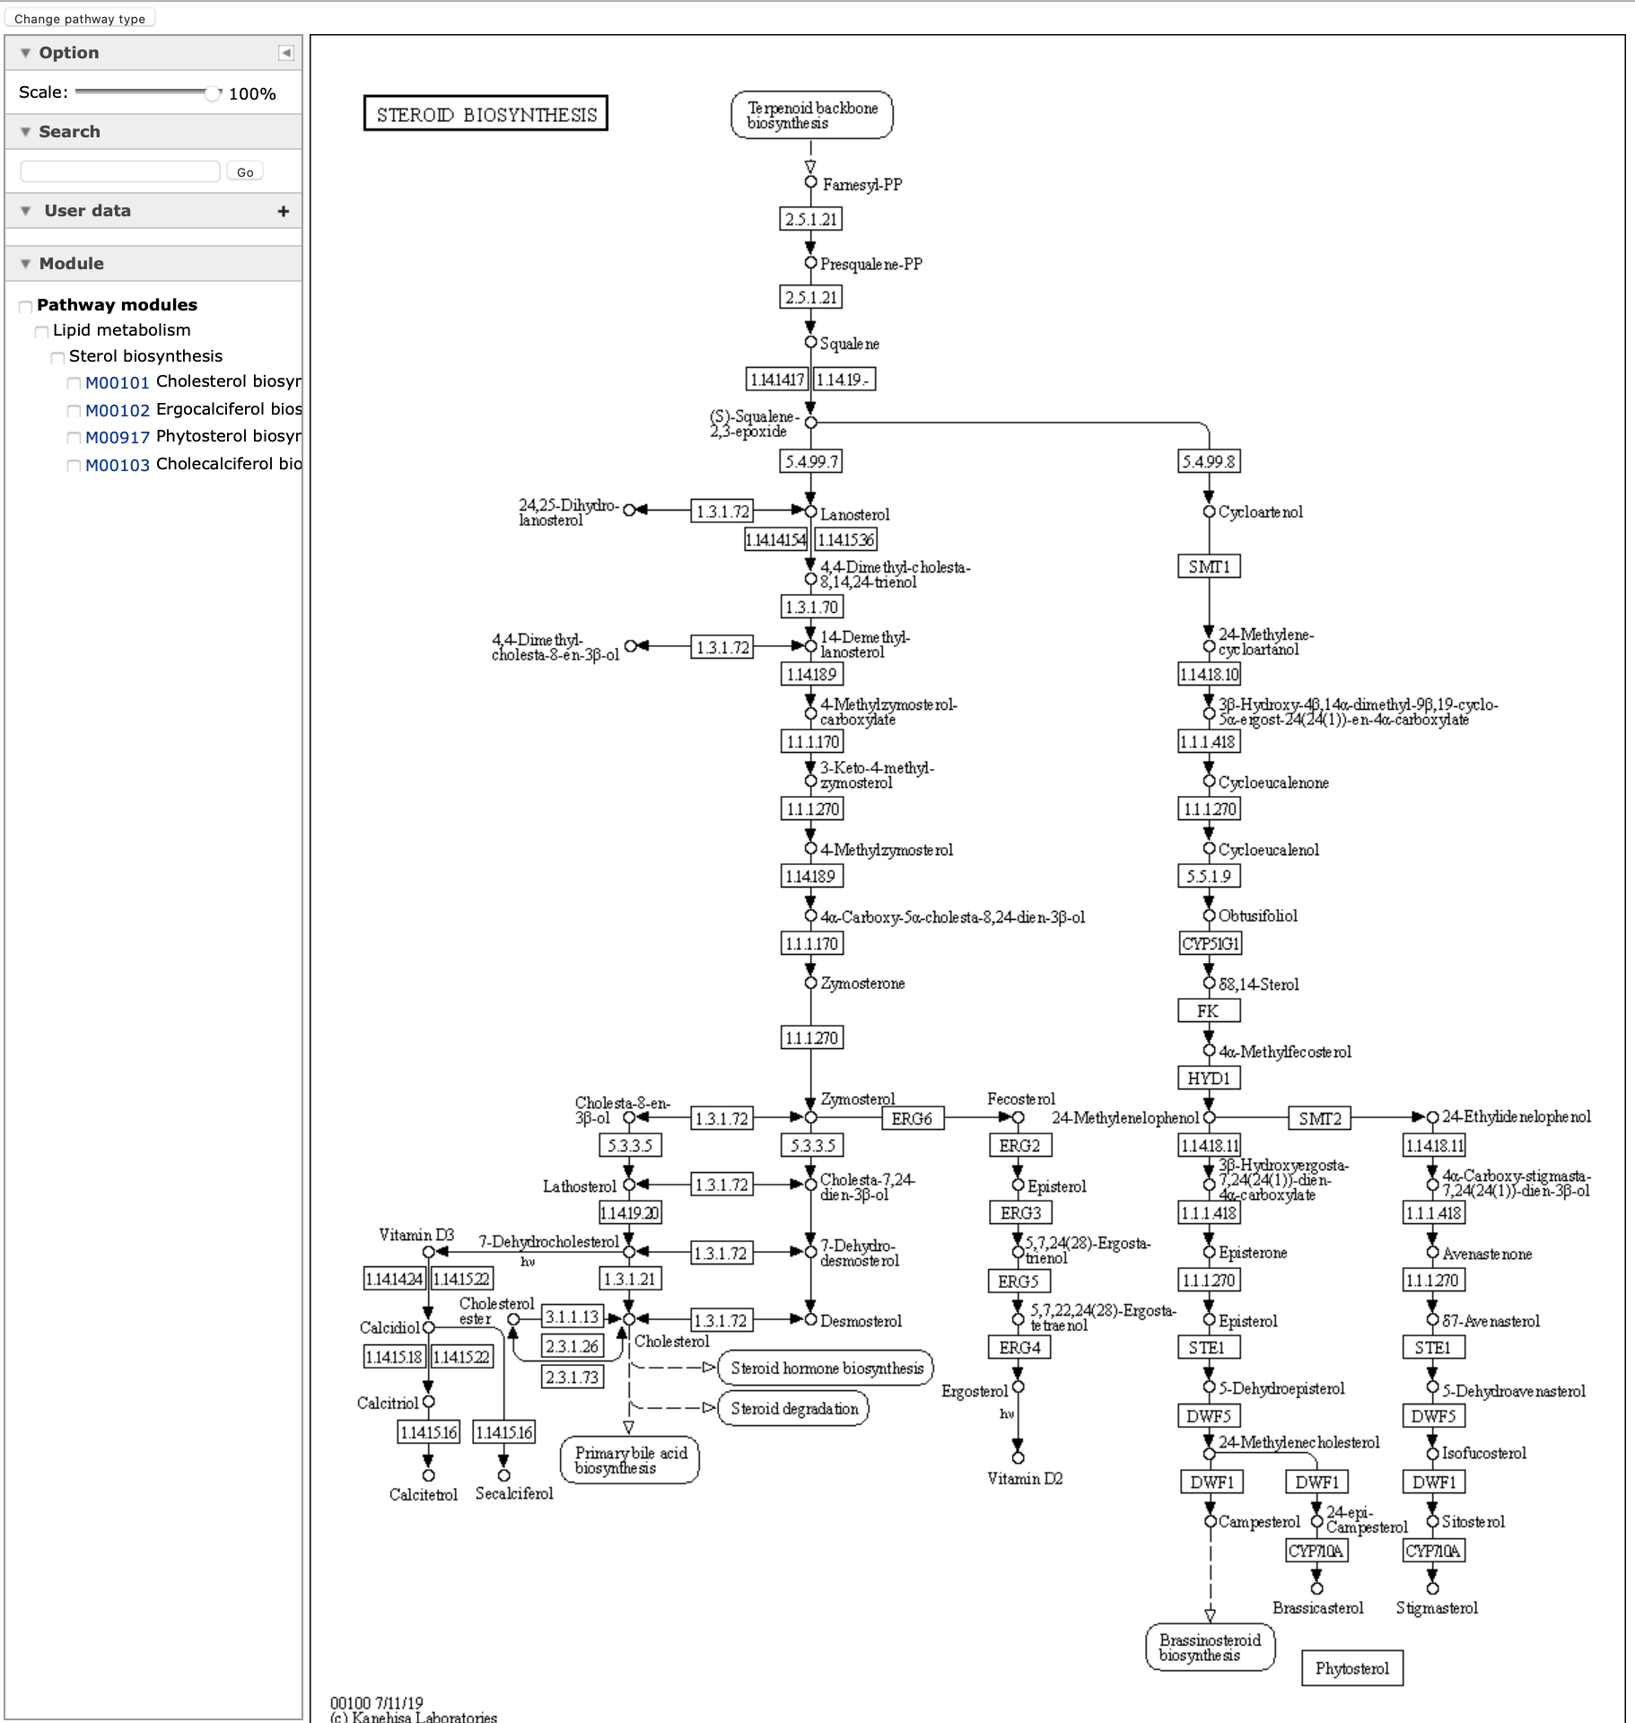
KEGG
Selecting the “steroid biosynthesis” pathway

Slide 40
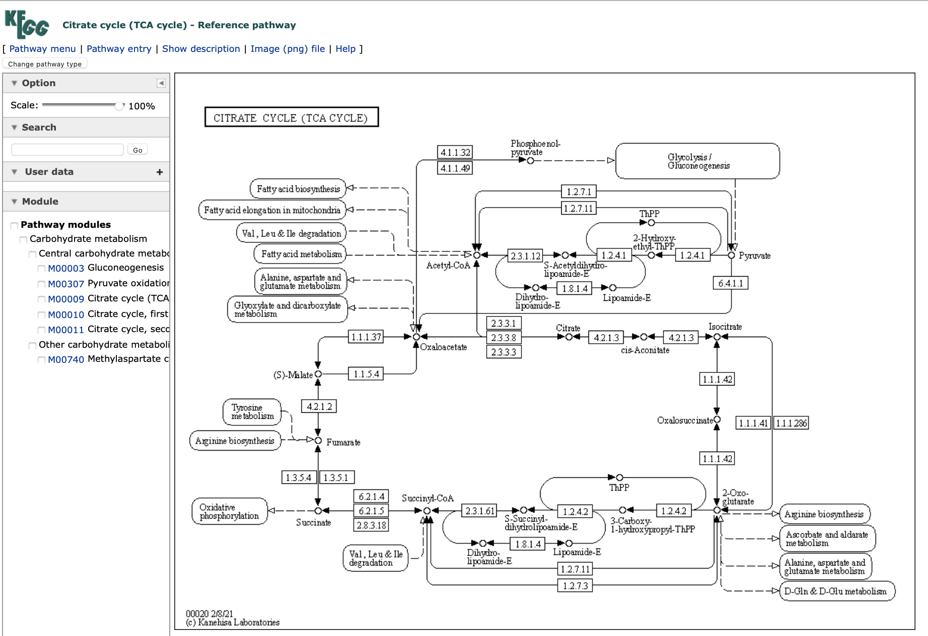
KEGG
Selecting TCA cycle
Click on a component, e.g.,
succinate

Slide 41
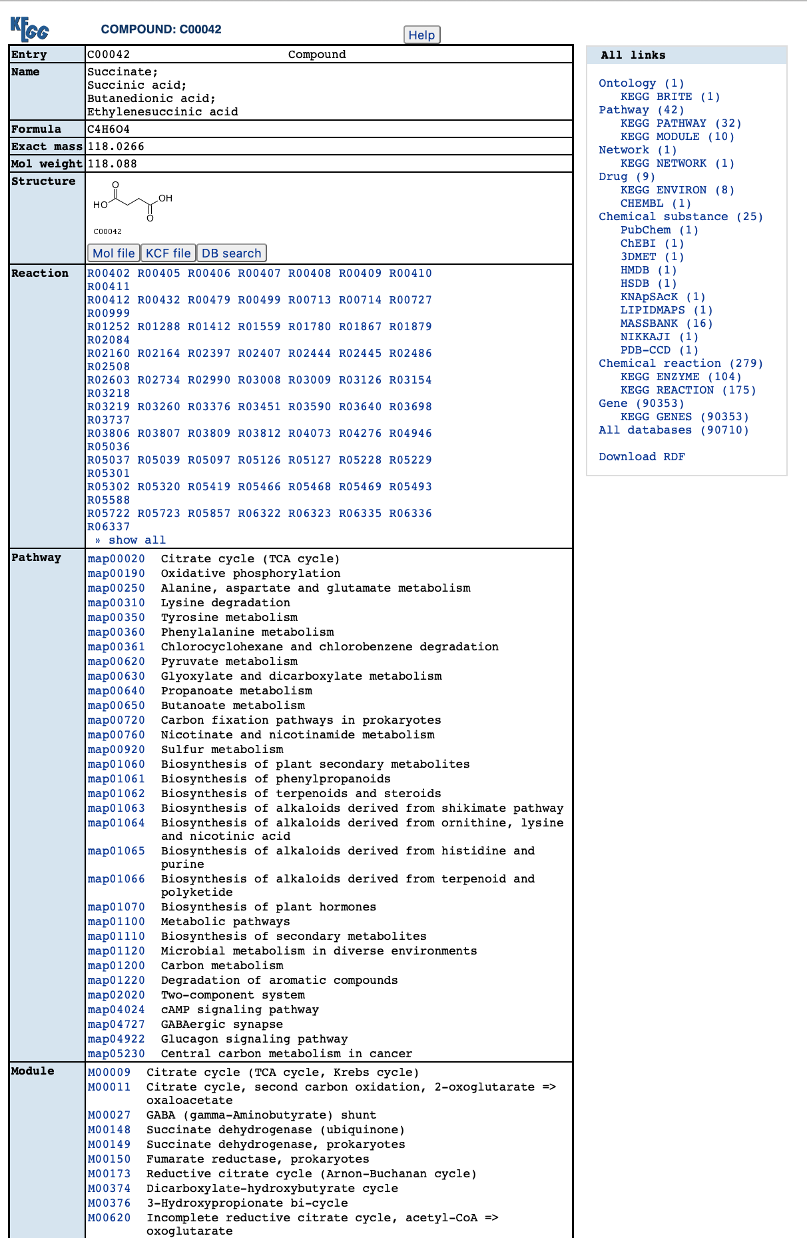
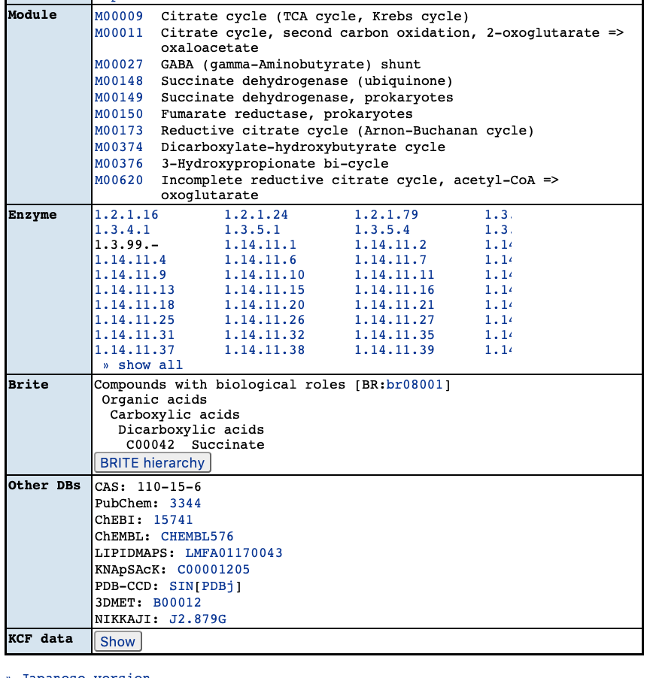
succinate

Slide 42
KEGG
Go back to the map and choose and enzyme (6.2.1.4)

Slide 43
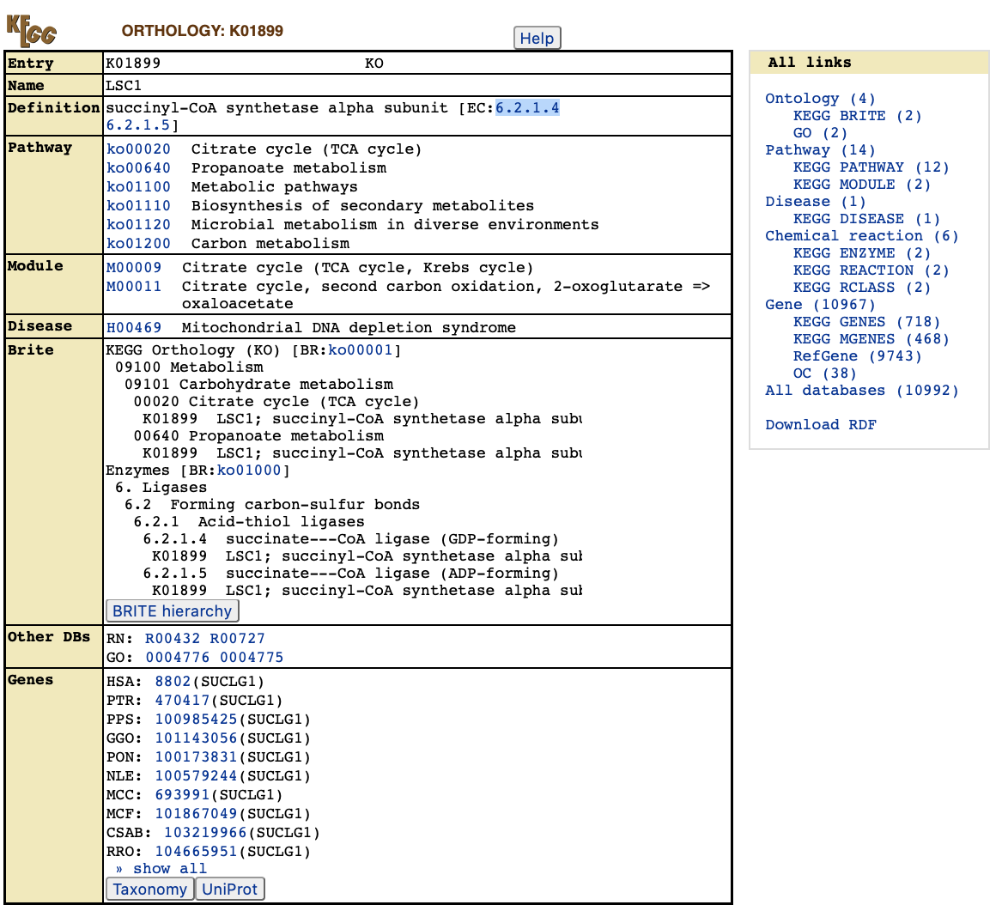
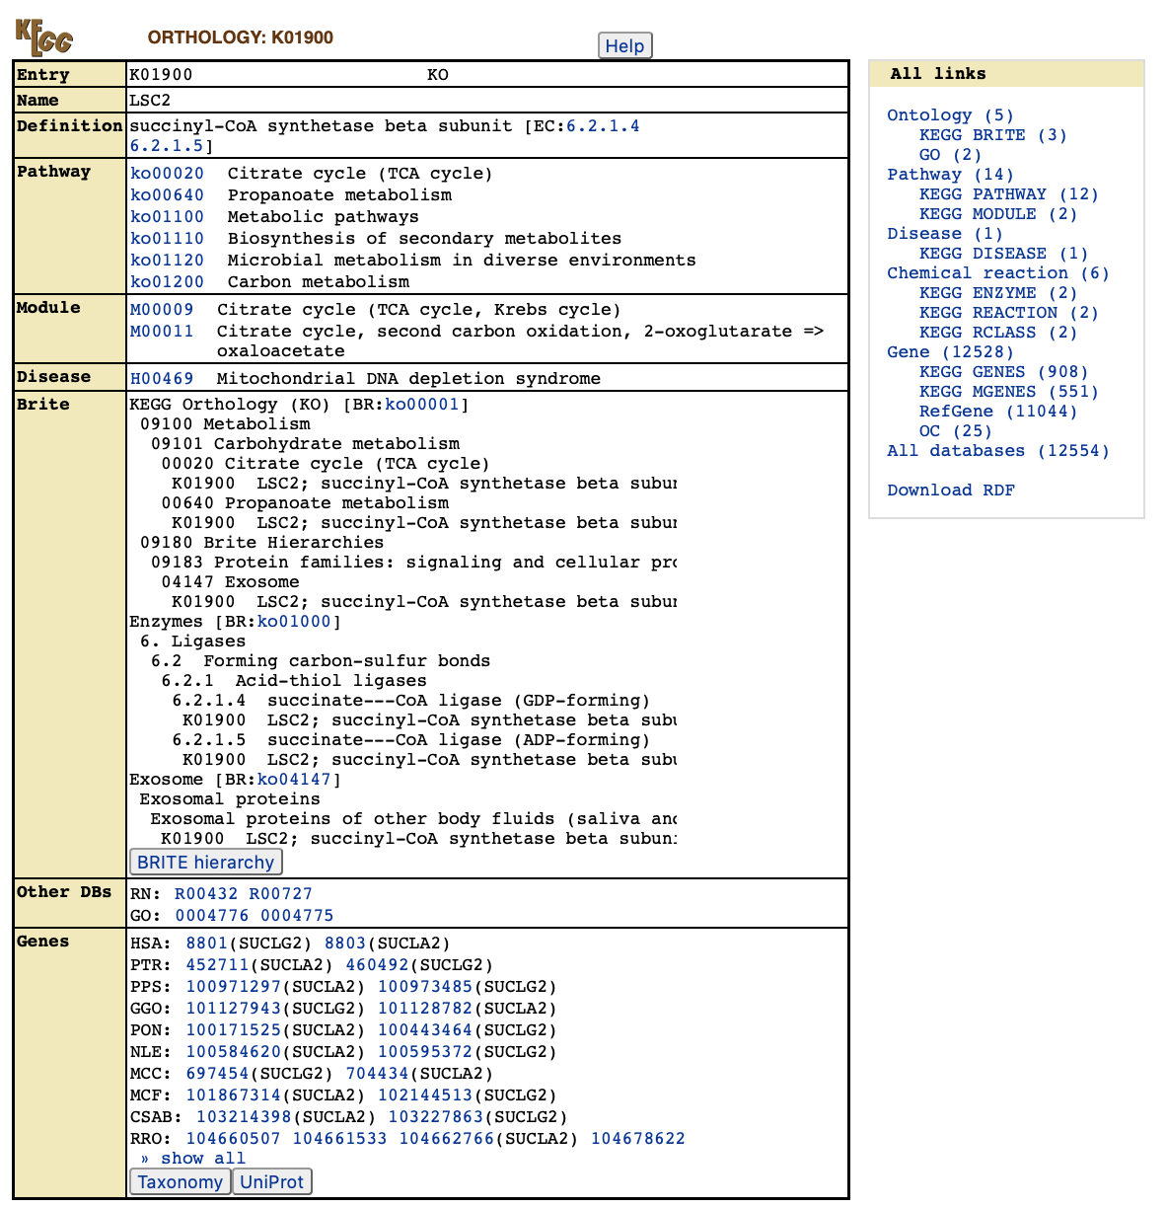
KEGG

Slide 44
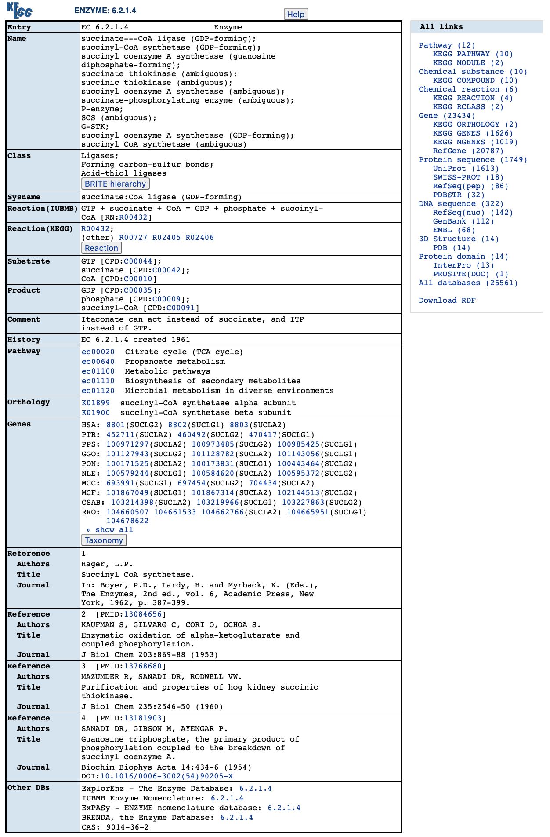
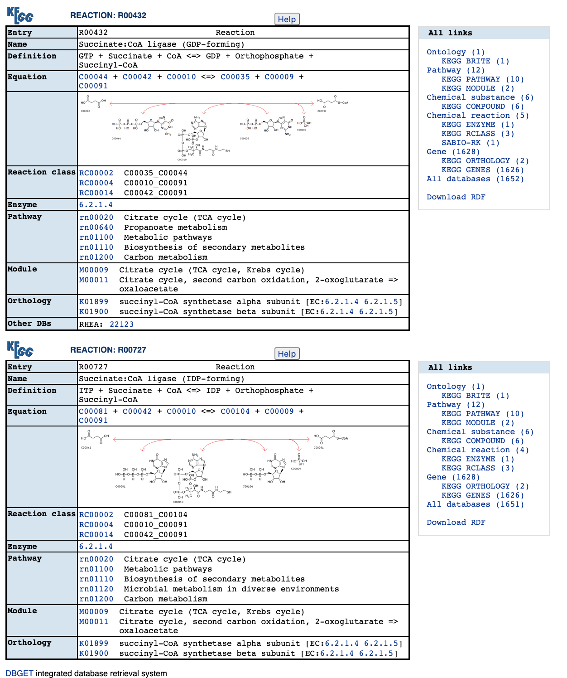

Slide 45
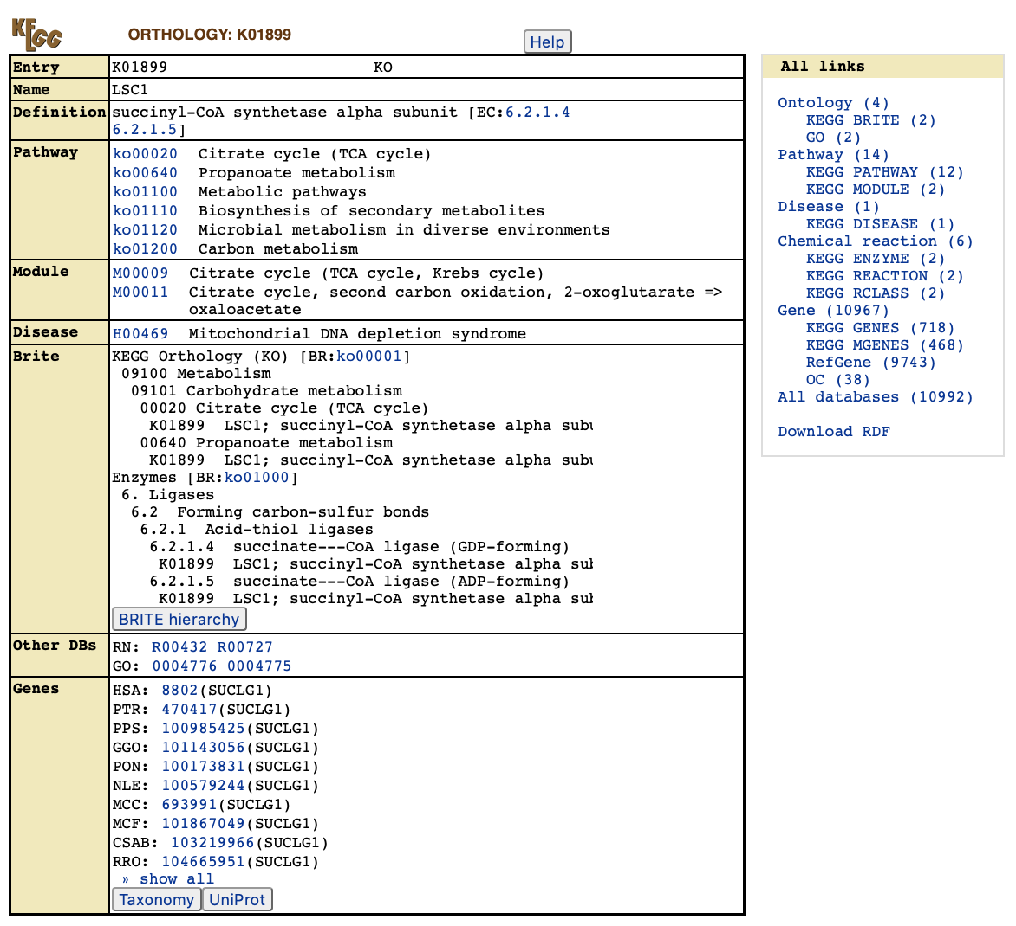
KEGG
Select the human gene

Slide 46
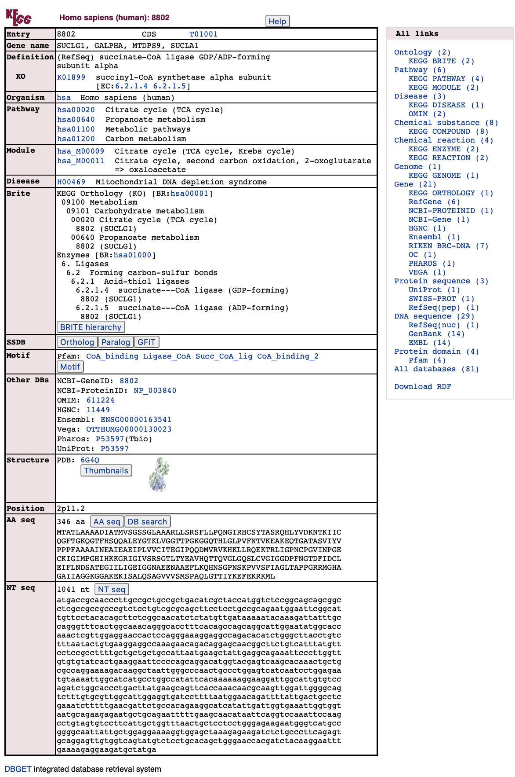
KEGG
Gene information for SUCLG1.
Pathways/modules the gene is associated with are listed.
There are links to other databases.

Slide 47
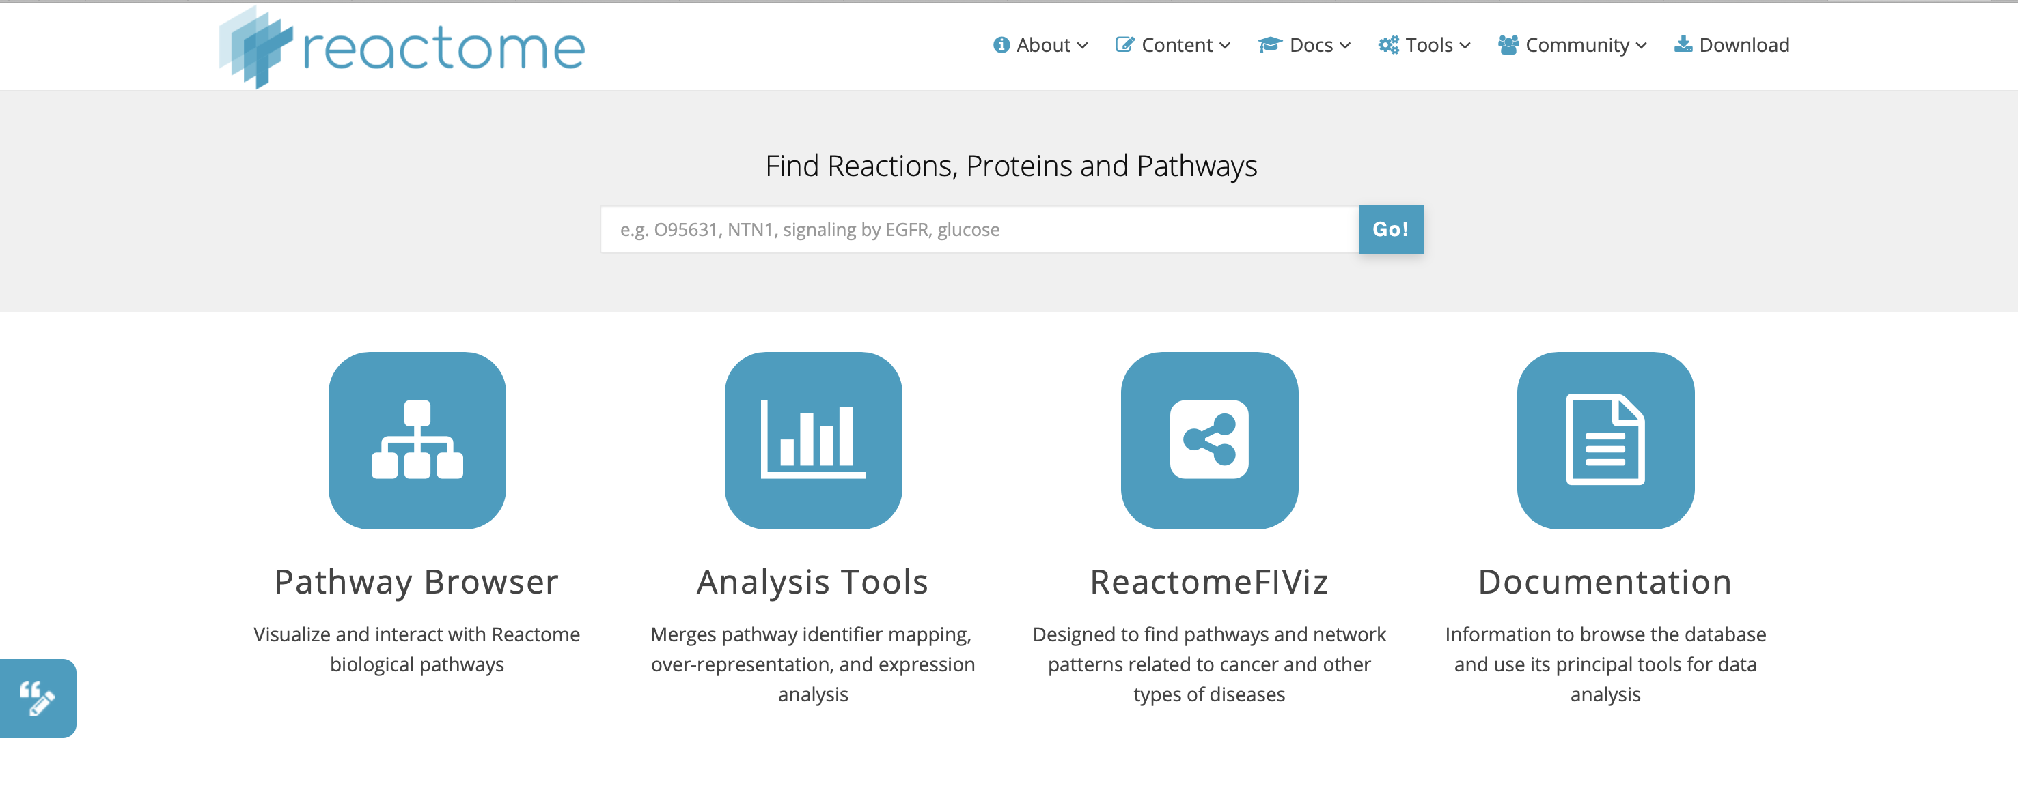
Reactome
reactome.org
Reactome is an online pathway database, with a focus on reactions.

Slide 48
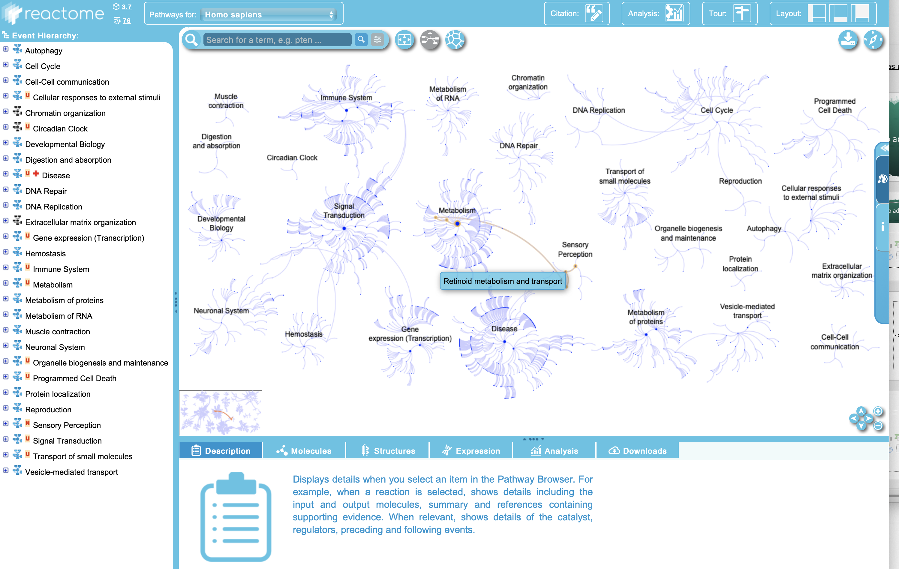
Reactome
https://reactome.org/PathwayBrowser/

Slide 49
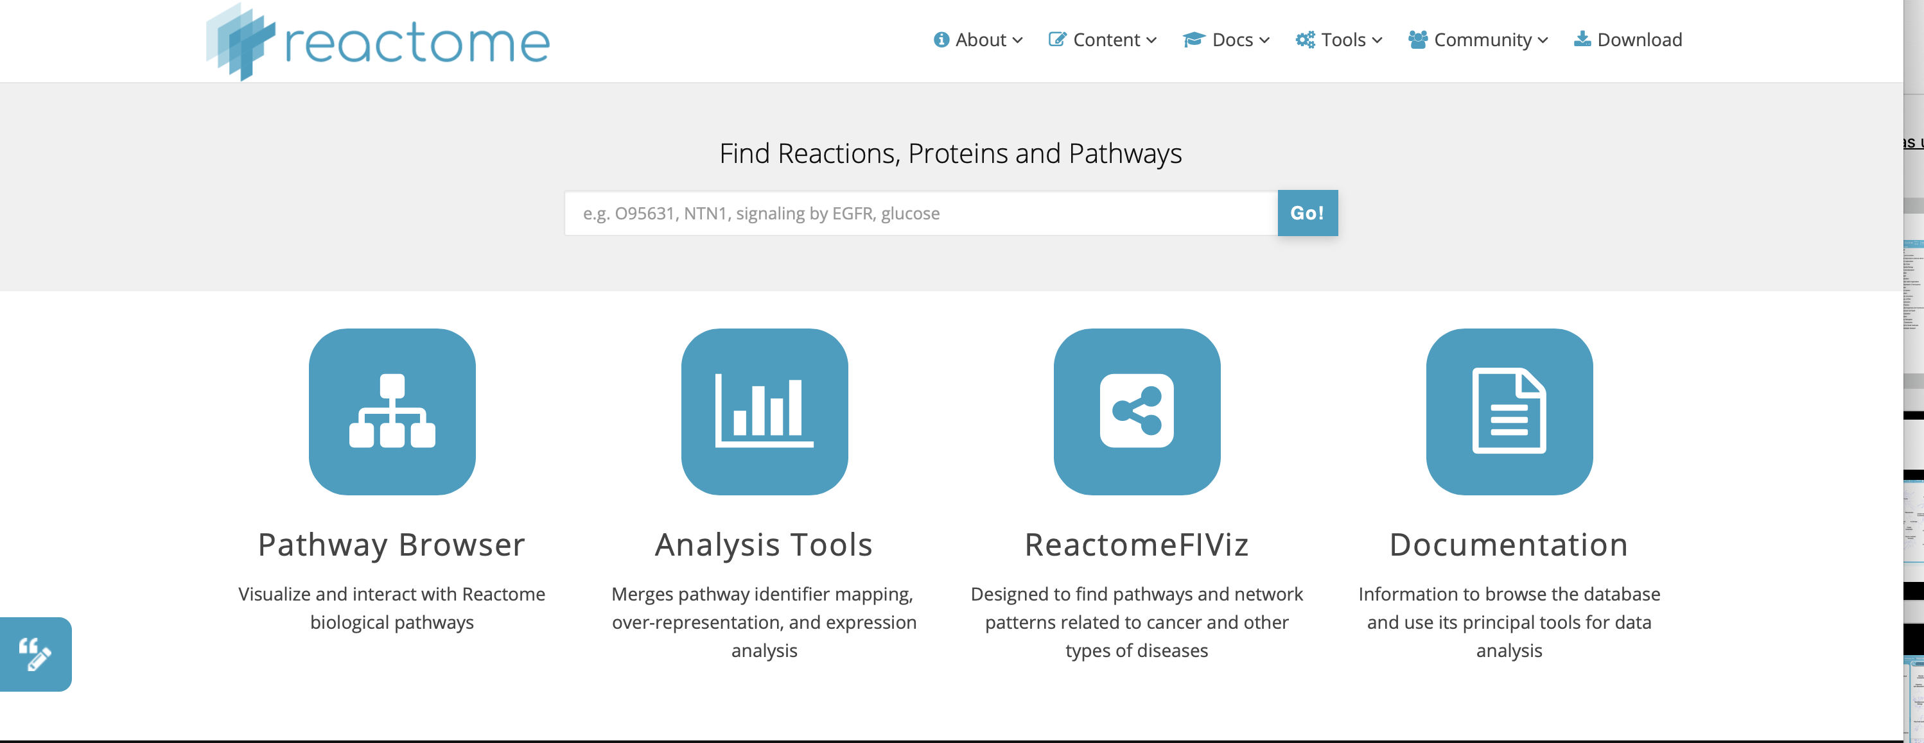
Reactome

Slide 50
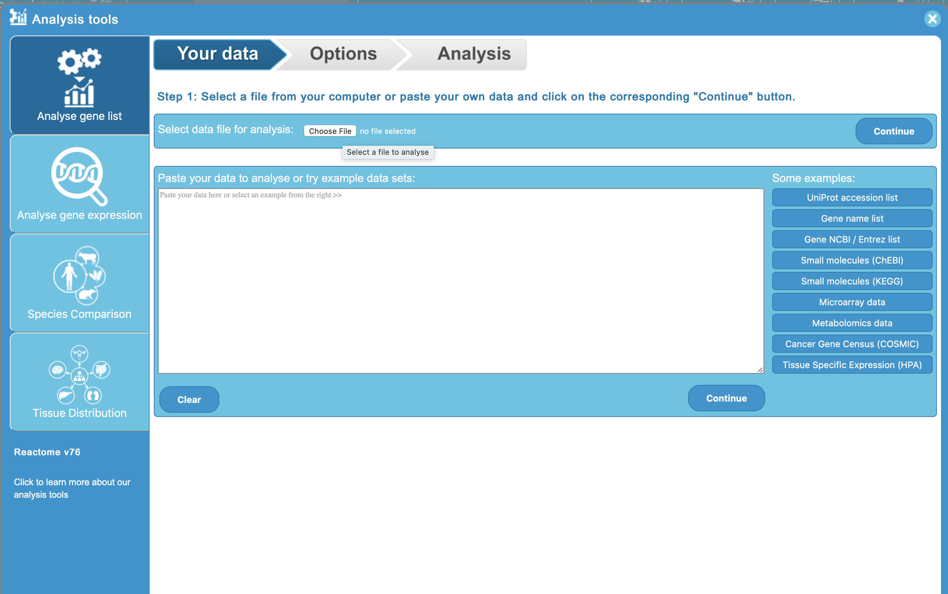
Reactome
Input:
SENP7
MOB1B
CARMIL1
PRRC2A
TERF2
RFWD3
PARP1
POT1
ATM
MPHOSPH6

Slide 51
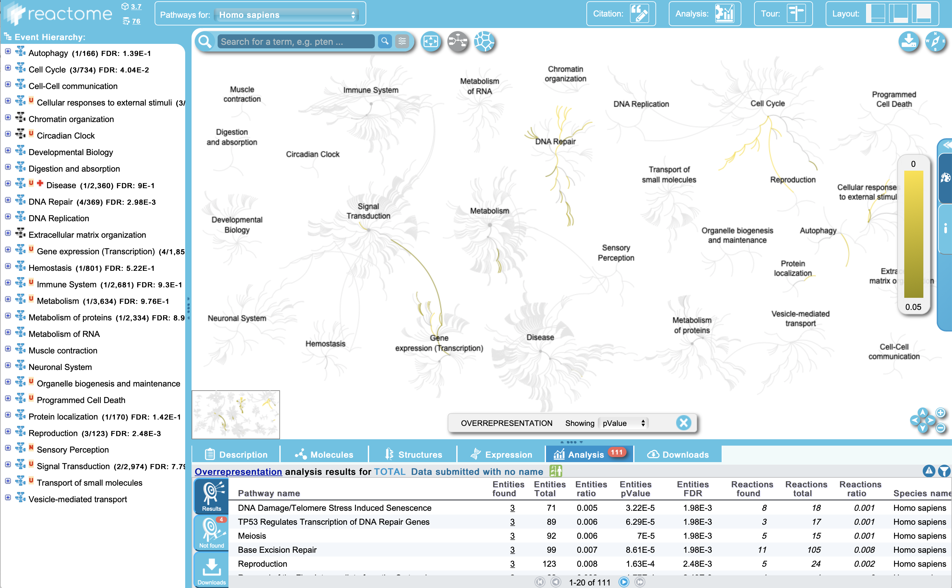
Reactome
Results

Slide 52
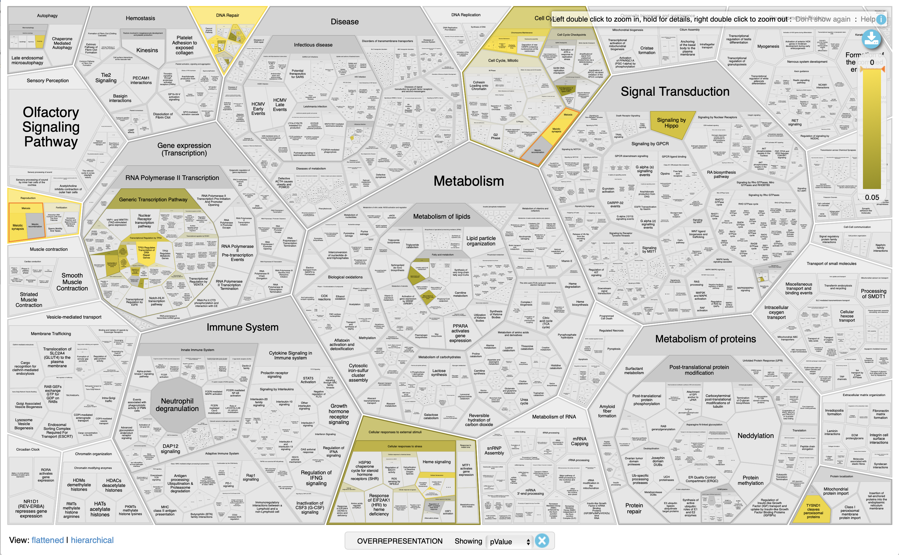
Reactome
Results

Slide 53
Gene set/pathway analysis in FUMA
Recall that FUMA’s SNP2GENE feature takes GWAS summary statistics and outputs a list of mapped genes.
The GENE2FUNC feature takes a set of genes as input and can perform overrepresentation analyses.
Gene sets include: Gene Ontologies, KEGG pathways, Reactome pathways, and DE genes across various tissues/cell types

Slide 54
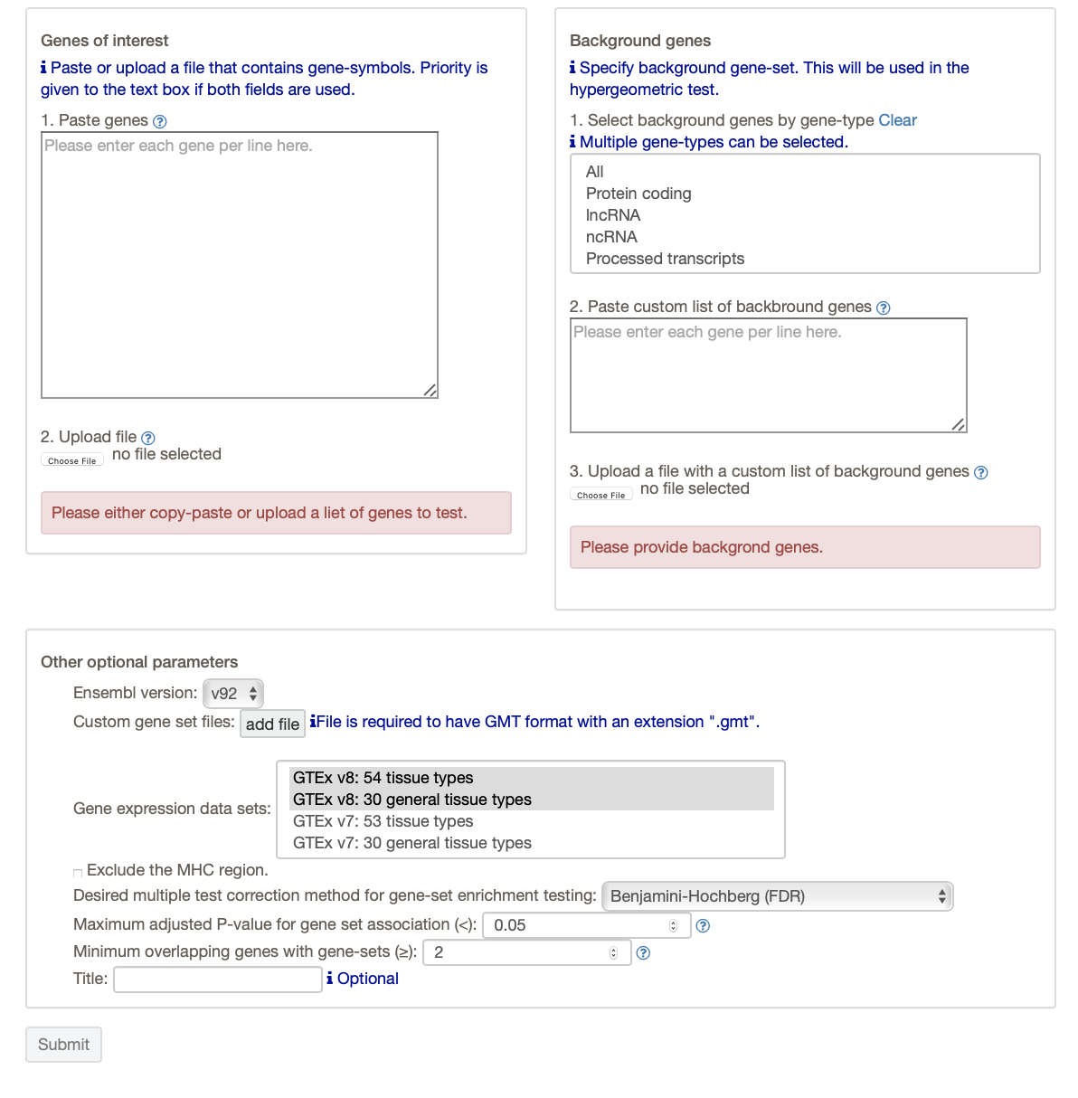
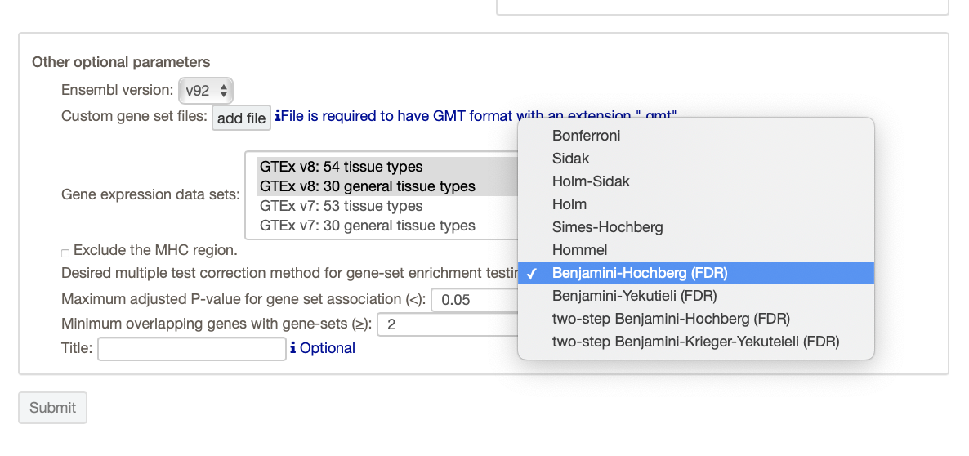
Gene set analysis in FUMA – GENE2FUNC
Provide a list of genes (copy and paste or upload a file).
You need to specify a “background” set of genes to compare your list with.
FUMA lets you select several different gene sets defined by gene expression profiles of various tissues.
You can also choose one of several multiple-testing correction methods and a “significance” threshold.

Slide 55
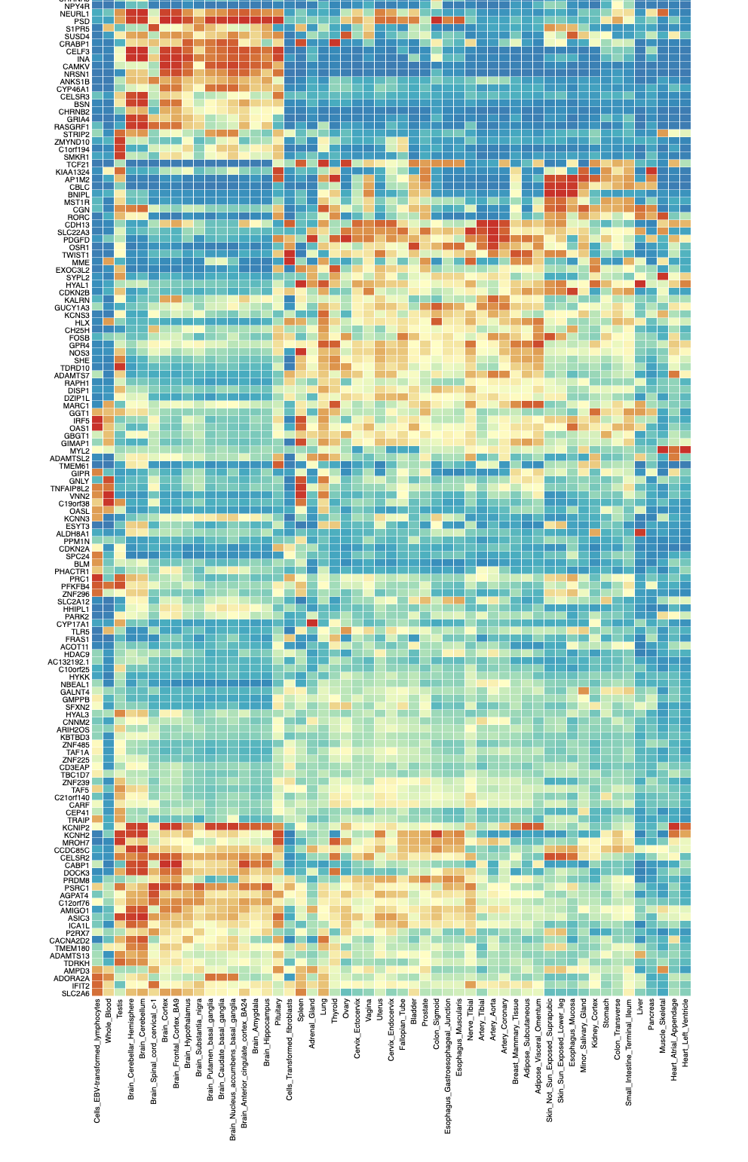
GENE2FUNC
Input: 644 genes from the hw4 data.
Output (first part): gene expression heatmap
https://fuma.ctglab.nl/browse/179#g2f_summaryPanel

Slide 56
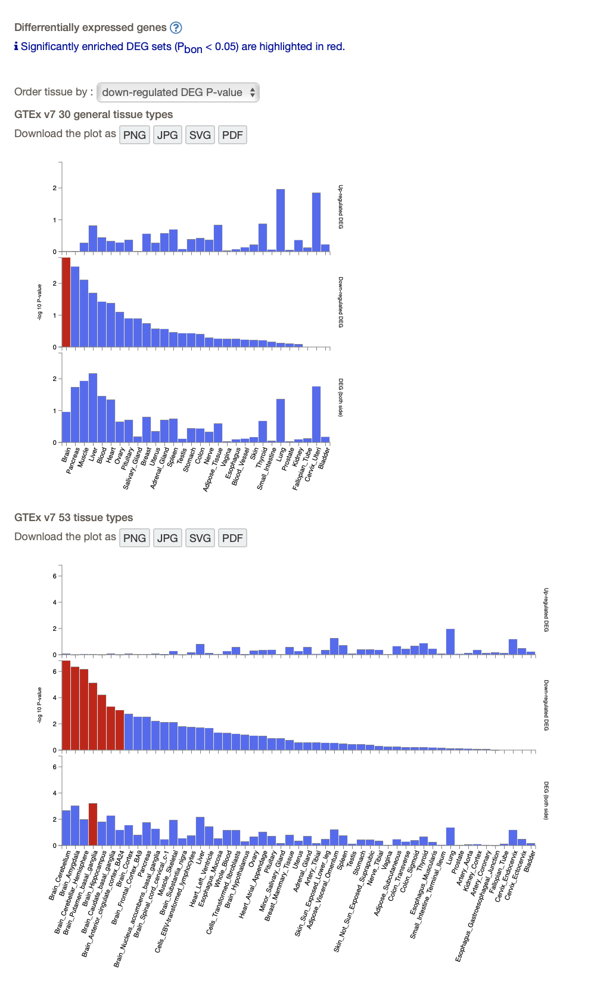
GENE2FUNC
Output (second part) Differential expression of genes across tissues
(Are the genes you supplied enriched for DE genes in particular tissues?)

Slide 57
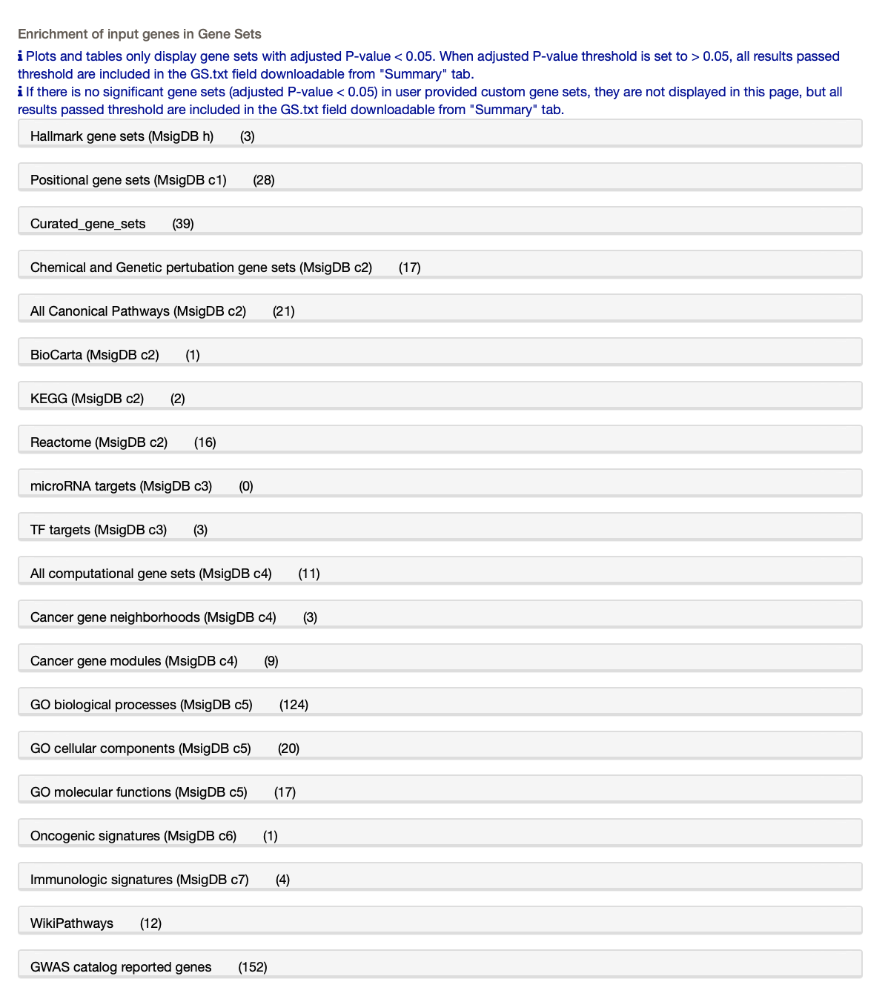
GENE2FUNC
Overrepresentation of your genes in pre-defined gene sets

Slide 58
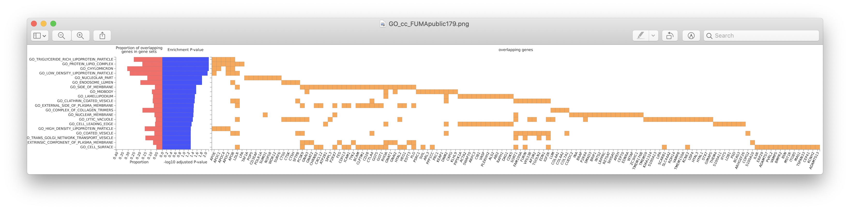
GENE2FUNC
For example, choose “GO cellular components”
You can see exactly which genes in our list overlapped with these 20 GO terms, and how significant the overlap/enrichment is.

Slide 59
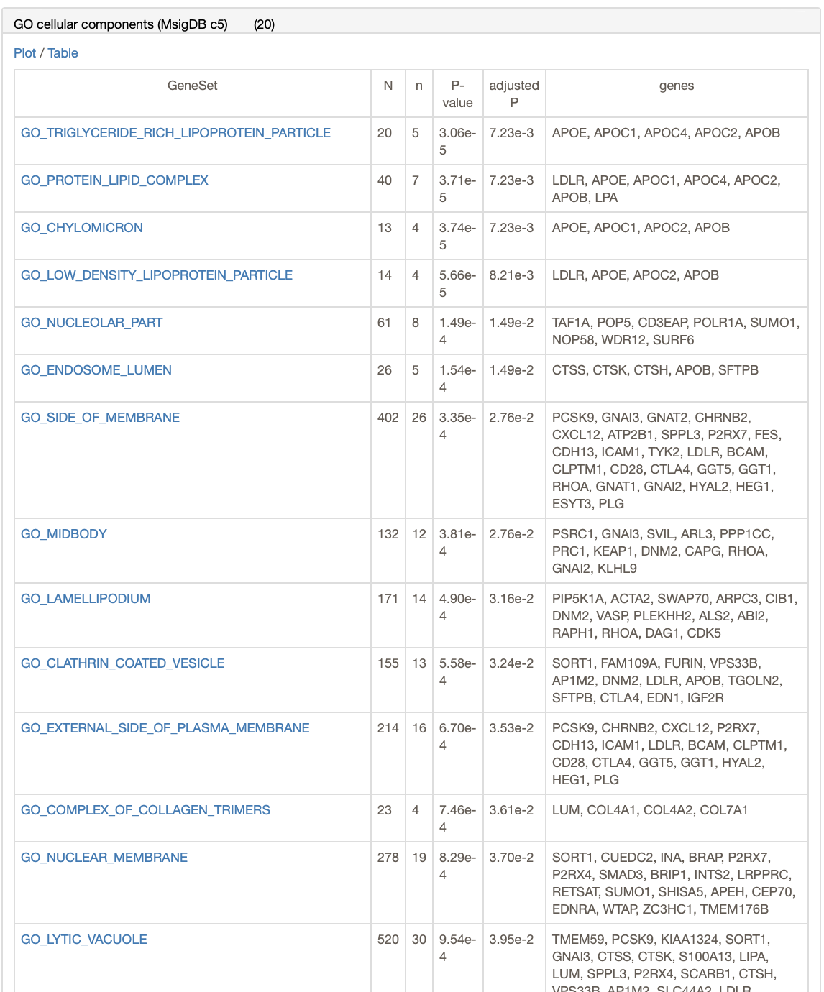
GENE2FUNC
Results are also viewable as a table.

Slide 60
One other FUMA function
Recall that FUMA uses GWAS summary statistics to perform gene-based testing in MAGMA.
MAGMA can integrate the gene-based p-values into a gene set testing framework.
Essentially this tests whether genes in a gene set are more strongly associated with the phenotype (compared to other genes).
Recall that this uses ALL genes, not just a set you chose.

Slide 61

MAGMA results
Gene sets defined by differential expression in various tissues.

Slide 62
GREAT
Genomic Regions Enrichment of Annotations
Publication http://bejerano.stanford.edu/papers/GREAT.pdf
Website http://great.stanford.edu/public/html/index.php
More documentation
https://great-help.atlassian.net/wiki/spaces/GREAT/overview?homepageId=655450

Slide 63

GREAT
Focus on “b”
Scenario: you want to know if some regions identified by your study are enriched for an annotation.
Arrows = gene transcription start sites
Black arrows = for genes without a specific annotation of interest
Green arrows = for genes without the annotation
Black lines = regulatory regions for gene without the annotation
Green arrows = regulatory regions for genes with the annotation
Calculate the fraction of the genome overlapping the green lines.
How many of your genomic regions overlap the green lines?
Perform a binomial test.

Slide 64

GREAT

Slide 65

GREAT
Select a species and provide input in BED format

Slide 66

GREAT
Example: plug in a list of 235 SNPs from a GWAS of height (http://great.stanford.edu/public/html/demo.php)

Slide 67

GREAT

Slide 68

GREAT
Output controls

Slide 69

GREAT
Example output for GO biological process

Slide 70

Other enrichment categories

Slide 71


GREAT
Mouse-based categories

Slide 72
Some limitations
For “over-representation”-based methods we’ve discussed
Genes are effectively all treated equally (expression fold-change, effect sizes of each gene is not considered)
Tends to discard genes not meeting a threshold (a somewhat arbitrary significance or fold-change cutoff is applied)
Genes are assumed independent (e.g., types/strengths of genes’ biological interactions are not considered)
Pathways/gene sets are assumed independent (though, e.g., GO terms are hierarchically ordered)
Notes:
https://journals.plos.org/ploscompbiol/article?id=10.1371/journal.pcbi.1002375#pcbi-1002375-g001

Slide 73
Some extensions
“Functional class scoring” (FCS) methods
Rather than using an arbitrary cutoff for including genes and weighing all genes equally, try to use, e.g., full matrix of expression data
One basic idea: calculate a score for each gene, then aggregate genes’ scores into pathway-level scores, and test for significance
Example: GSEA (gene set enrichment analysis)

Slide 74
Example: GSEA
Rank genes by effect on/correlation with phenotype.
GSEA calculates the ES by walking down the ranked list of genes, increasing a running-sum statistic when a gene is in the gene set and decreasing it when it is not.
The magnitude of the increment depends on the correlation of the gene with the phenotype. The ES is the maximum deviation from zero encountered in walking the list. A positive ES indicates gene set enrichment at the top of the ranked list; a negative ES indicates gene set enrichment at the bottom of the ranked list.
The top portion of the plot shows the running ES for the gene set as the analysis walks down the ranked list. The score at the peak of the plot (the score furthest from 0.0) is the ES for the gene set. Gene sets with a distinct peak at the beginning (such as the one shown here) or end of the ranked list are generally the most interesting.
Use a permutation procedure to normalize the ES and assign each gene set an enrichment p-value. Adjust for multiple testing/try to control FDR.
(Numerous implementations exist.)
Notes:
https://www.gsea-msigdb.org/gsea/doc/GSEAUserGuideFrame.html#:~:text=Gene%20Set%20Enrichment%20Analysis%20(GSEA)%20is%20a%20computational%20method%20that,biological%20states%20(e.g.%20phenotypes).

Slide 75
Other extensions
Pathway topology (PT)-based approaches
ORA/FCS methods don’t use “structure” of gene sets
PT-based methods do Review/comparison: https://bmcbioinformatics.biomedcentral.com/articles/10.1186/s12859-019-3146-1
Some approaches
Computing similarities for gene pairs in a pathway and adjusting for their “distance” in the pathway → gene score → pathway score
“Impact factor” approach: treat signaling pathway as a graph, using its connectivity structure to model a pathway score as a weighted sum involving differential expression of each gene in the pathway
Some limitations: pathway connectivity could vary across cell types or with experimental conditions

Slide 76
Some other challenges
Need for “higher-resolution” databases
Lots of alternative splicing → the “same gene” (as labeled in a pathway or gene set) could have various different meanings/contexts in a given pathway, though the pathway may have only one representation in databases
In an association study, how does a SNP affect associated with a phenotype affect a pathway?
Missing/biased data
How should non protein-coding elements like pseudogenes be included? (They may be transcribed/affect pathways)
> 95% of GO term assertions (as of 2007) are inferred from electronic annotations (and more likely lower in quality or incorrect)
Lots more “manual” annotation needed

Slide 77
Some other challenges (con’t.)
Condition- and cell-specificity
Databases are built from experiments on certain cell types in certain tissues and may not generalize; this context may be unavailable.
Different “variations” of the “same” pathway from different contexts may erroneously lead to two genes that are actually independent to be grouped together in a gene set; this can inflate the number of genes in a pathway and lead to spurious GSA associations
“Canonical” pathways way differ from disease- or phenotypic-specific pathways

Slide 78
Some other challenges (con’t.)
Benchmarks
Lack of a “gold standard” since ”the full biology” is generally not known; simulations can’t answer everything.

